Slide 1
The Rights of Children, Women and Stateless persons in the Context of Migration : Instruments and principles
International Migration Law Unit

Slide 2
Objectives of this session
After this session, you will be able to better explain the:
the applicable legal framework on the rights of children, women and stateless persons
principles and obligations of States at every stage of migration.

Slide 3
Rights of children within the context of migration
Instruments and Principles

Slide 4
Main Definitions
Child:
Art. 1 of the Convention of the Rights of the Child:
Every human being below the age of 18 years
Unaccompanied children
Children as defined under Art. 1 of the Convention on the Rights of the Child who have been :
separated from both parents and other relatives AND
Not being cared for by an adult who is responsible for doing so
Adapted from Committee on the Rights of the Child, General Comment No. 6: Treatment of Unaccompanied and Separated Children Outside their Country of Origin 1 September 2005 CRC/GC/2005/6, para. 7.
Separated Children:
Children as defined under Art. 1 of the Convention on the Rights of the Child who have been :
separated from both parents/primary caregiver, but not necessarily from other relatives;
Children accompanied by other adult family members
Adapted from Committee on the Rights of the Child, General Comment No. 6: Treatment of Unaccompanied and Separated Children outside Their Country of Origin (1 September 2005) UN Doc CRC/ GC/2005/6, para. 8.

Slide 5

Overview : Migrant Children and International Human Rights Law
1966
1966
1965
1979
International Covenant on Civil and Political Rights (ICCPR)
International Covenant on Economic, Social and Cultural Rights (ICESCR)
The Convention on the Elimination of All Forms of Racial Discrimination (CERD)
Convention on the Elimination of All Forms of Discrimination against Women (CEDAW)
1984
1989*
1990
2006
Convention against Torture and Other Cruel, Inhuman or Degrading Treatment or Punishment (CAT)
Convention on the Rights of the Child (CRC)
International Convention on the Protection of the Rights of All Migrant Workers and Members of Their Families (ICRMW)
Convention on the Rights of Persons with Disabilities (CRPD)

Slide 6
Other sources within the UN System
1951 UN Convention relating to the Status of Refugees
1989 Human Rights Committee, General Comment No. 17 on the rights of the child (Article 24)
1993 Hague Convention on the Protection of Children and Cooperation in Respect of Intercountry Adoption
1999 Convention on the Worst Forms of Child Labour
2000 Protocol to Prevent, Suppress and Punish Trafficking in Persons, Especially Women and Children, supplementing the United Nations Convention against Transnational Organized Crime
2000 Optional Protocol to the Convention on Rights of Child on the Sale of Children, Child Prostitution, and Child Pornography
2005 CRC General Comment no 6 (Unaccompanied and separated children)
2012 Day of General Discussions (The rights of all children in the context of international migration)
2016 Report of the UN Secretary General (In Safety and Dignity, Addressing Large Movements of Refugee and Migrants)
2016 New York Declaration for Refugee and Migrants
Joint general comment No. 3 (2017) of the Committee on the Protection of the Rights of All Migrant Workers and Members of Their Families and No. 22 (2017) of the Committee on the Rights of the Child on the general principles regarding the human rights of children in the context of international migration

Slide 7
Convention on the Rights of the Child (CRC)
Optional Protocol to the CRC on the Involvement of Children in Armed Conflict (2002)
Optional Protocol to the CRC on the Sale of Children, Child Prostitution and Child Pornography (2002)
Two Optional Protocols
Adopted in 1989, is the main international instrument and the most comprehensive one on the rights of children.
Virtually every aspect of a child’s life is covered – including rights to a name and registration at birth, nationality, health, education, etc.

Slide 8

Fundamental principles of the CRC:
Under the Convention, States are responsible to guarantee a broad set of rights of children.
The enjoyment of rights is not limited to national children but applies and must be available to all children, including asylum-seeking, refugee and migrant children, irrespective of their nationality, immigration status or statelessness.
Non-discrimination
Art 2 CRC
Family unity
Art.16 CRC
Best interest
Art 3 CRC
Life and full development
Art 6 CRC
Non refoulement
Art 6 and 37 CRC
Participation
Art.12 CRC

Slide 9
Best interest of the child
Best interest of the child should be taken into consideration (a primary consideration) in
  all measures and decisions taken in relation to migrant children, unaccompanied children and displaced children.
  whether undertaken by public or private social welfare institutions, courts of law, administrative authorities or legislative bodies.
Best Interest principle to guide decisions on
  Entry
  Residence
  Placement and care for the child,
  Detention
  Return
  (Re)Integration
To be considered also in decisions regarding parents and legal guardians

Slide 10
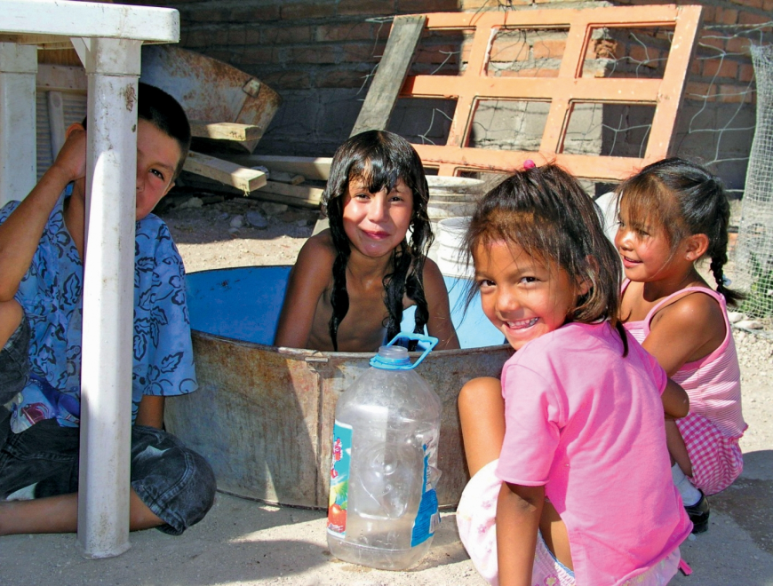
Best interest of the child
Joint General Comments CRC-CRMW 2018, Pag. 6/7
28. Recognizing that the best interests of the child — once assessed and determined — might conflict with other interests or rights (e.g. of other children, the public and parents) and that potential conflicts have to be resolved on a case-by-case basis, carefully balancing the interests of all parties and finding a suitable compromise, the Committee stresses in paragraph 39 of its general comment No. 14 that the right of the child to have his or her best interests taken as a primary consideration means that the child’s interests have high priority and are not just one of several considerations.
29. States parties shall ensure that the best interests of the child are taken fully into consideration in immigration law, planning, implementation and assessment of migration policies and decision-making on individual cases

Slide 11
Children at the border
2005 CRC General Comment no 6 (Unaccompanied and separated children)
“State obligations under the Convention apply within the borders of a State, including with respect to those children who come under the State’s jurisdiction while attempting to enter the country’s territory.
Therefore, the enjoyment of rights stipulated in the Convention is not limited to children who are citizens of a State party and must therefore, if not explicitly stated otherwise in the Convention, also be available to all children – including asylum-seeking, refugee and migrant children – irrespective of their nationality, immigration status or statelessness

Slide 12
Screening/ interviewing at the border
Ensure that migrant children are promptly identified and, if unaccompanied or separated, are swiftly appointed a competent and impartial legal guardian, that family unity is protected, and that anyone legitimately claiming to be a child is treated as such ; Relevant information is provided
OHCHR’s Recommended Principles and Guidelines on Human Rights at International Borders – 2014; Global Compact for Migration (GCM):
Limiting interviews carried out by border authorities with children to only gather basic information about the child’s identity.
OHCHR’s Recommended Principles and Guidelines on Human Rights at International Borders - 2014
Children travelling with adults should be verified as being accompanied by or related to them, including through separate interviews with appropriately trained and qualified personnel.
OHCHR’s Recommended Principles and Guidelines on Human Rights at International Borders - 2014
Establish gender-responsive and child-sensitive referral mechanisms, including improved screening measures and individual assessments at borders and places of first arrival, by applying standardized operating procedures developed in coordination with local authorities, National Human Rights Institutions, international organizations and civil society
GCM Objective 12 (28 e)
Ensure that child protection authorities are promptly informed and assigned to participate in procedures for the determination of the best interests of the child once an unaccompanied or separated child crosses an international border, in accordance with international law, including by training border officials in the rights of the child and child sensitive procedures, such as those that prevent family separation and reunite families when family separation occurs
GCM Obj 11 (27 e); OHCHR’s Recommended Principles and Guidelines on Human Rights at International Borders – 2014

Slide 13
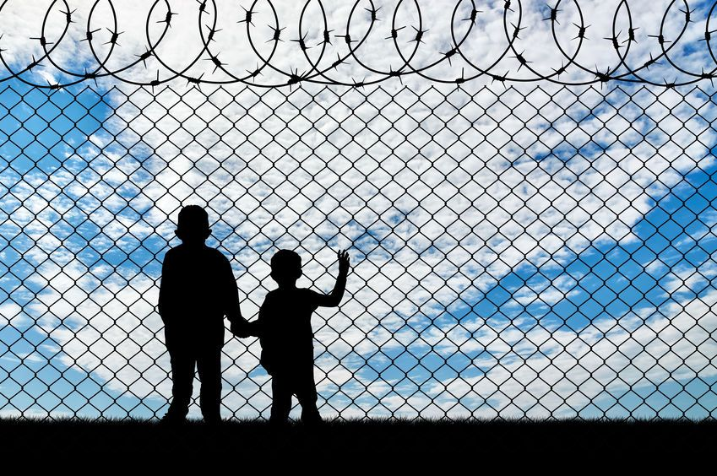
Non detention
Joint general comment No. 4 (2017) of the CMW and No. 23 (2017) of the CRC on State obligations regarding the human rights of children in the context of international migration in countries of origin, transit, destination and return
Every child, at all times, has a fundamental right to liberty and freedom from immigration detention.
Detention of any child because of their or their parents’ migration status constitutes a child rights violation and contravenes the principle of the best interests of the child.
Children should never be detained for reasons related to their or their parents’ migration status and States should expeditiously and completely cease or eradicate the immigration detention of children. Any kind of child immigration detention should be forbidden by law and such prohibition should be fully implemented in practice
Adopt solution that fulfil the best interests of the child, along with their rights to liberty and family life, through legislation, policy and practices that allow children to remain with their family members and/or guardians in non-custodial, community-based contexts while their immigration status is being resolved and the children’s best interests are assessed
Committee on the Rights of the Child, general comment No. 6 (2005) on treatment of unaccompanied and separated children outside their country of origin, para. 61.)
children should not be deprived of their liberty and that detention cannot be justified solely on the basis of the child being unaccompanied or separated, or on their migratory or residence status or lack thereof

Slide 14
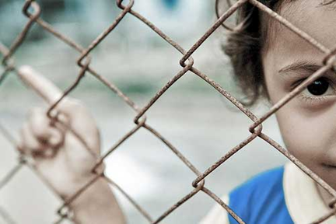
Non detention
Child immigration detention is a violation of the child’s right.
Long lasting harmful consequences for the child = Never in the child’s best interests
Non-custodial alternatives are possible and must be developed
Family unity, a right of the child and of any individual, means that separation of the child from the parents must not happen (unless the parents are a danger for the child)
  The right to family unity is in fact recognised by different international and regional binding instruments
Guarantee to children both freedom of movement and family life
Protect and respect the rights and best interests of the child at all times, regardless of their migration status, by ensuring availability and accessibility of a viable range of alternatives to detention in non-custodial contexts, favouring community-based care arrangements, that ensure access to education and healthcare, and respect their right to family life and family unity, and by working to end the practice of child detention in the context of international migration.
GCM OBJECTIVE 13: Use immigration detention only as a measure of last resort and work towards alternatives

Slide 15
Return
Migrant children only have right to stay in the country of destination under the conditions set in the law- Children can be thus returned to their countries of origin.
However, much higher threshold : returns must be consistent with respect for the rights of the child, given due consideration for the child’s best interest and the need to look for durable solutions
The child cannot be returned if there is a risk to his or her life and safety, including re-trafficking. Principle of non-refoulement
Where possible return assistance and support should be provided
Need to ensure that a legal guardian is available in the country of return before repatriation
Return in an institution, as opposed to family/foster home, is not in best interest most of the time. In that case, return should not be ordered
Child’s participation and views must be heard and given consideration to assess his or her best interest

Slide 16
Return
GCM, OBJECTIVE 21: Cooperate in facilitating safe and dignified return and readmission, as well as sustainable reintegration
Joint General Comments CRC-CRMW 2018, Pag. 8
  Promote gender-responsive and child-sensitive return and reintegration programmes, that may include legal, social and financial support, guaranteeing that all returns in the context of such voluntary programmes effectively take place on the basis of the migrant’s free, prior and informed consent, and that returning migrants are assisted in their reintegration process through effective partnerships, including to avoid they become displaced in the country of origin upon return.
  Ensure that return and readmission processes involving children are carried out only after a determination of the best interests of the child, take into account the right to family life, family unity, and that a parent, legal guardian or specialized official accompanies the child throughout the return process, ensuring that appropriate reception, care and reintegration arrangements for children are in place in the country of origin upon return
States parties are obliged, in line with article 3 of the Convention on the Rights of the Child, to ensure that any decision to return a child to his or her country of origin is based on evidentiary considerations on a case-by-case basis and pursuant to a procedure with appropriate due process safeguards, including a robust individual assessment and determination of the best-interests of the child.

Slide 17
Trafficking in children
The 1989 Convention on the Rights of the Child
States “shall protect the child against all other forms of exploitation prejudicial to any aspects of the child’s welfare” (Art. 36).
The 1990 International Convention on the Protection of the Rights of All Migrant Workers and Members of Their Families
Worst Forms of Child Labour Convention, 1999 (No. 182)
Article 3: Worst forms of child labour comprises (a) all forms of slavery or practices similar to slavery, such as the sale and trafficking of children, debt bondage and serfdom and forced or compulsory labour, including forced or compulsory recruitment of children for use in armed conflict; (b) the use, procuring or offering of a child for prostitution, for the production of pornography or for pornographic performances ;(c) the use, procuring or offering of a child for illicit activities, in particular for the production and trafficking of drugs as defined in the relevant international treaties;
States parties must “take all appropriate national, bilateral and multilateral measures to prevent the abduction of, the sale of or traffic in children for any purpose or in any form” (Art. 35);
The 2000 Optional Protocol to the Convention on the Rights of the Child on the sale of children, child prostitution and child pornography,
States must “take all necessary steps to strengthen international cooperation by multilateral, regional and bilateral arrangements for the prevention, detection, investigation, prosecution and punishment of those responsible for acts involving the sale of children, child prostitution, child pornography and child sex tourism” (Art. 10);
“[n]o migrant worker or member of his or her family shall be held in slavery or servitude” and that “[n]o migrant worker or member of his or her family shall be required to perform forced or compulsory labour” (Art. 11);
2000 , The Protocol to Prevent, Suppress and Punish Trafficking in Persons, Especially Women and Children
comprehensively responding to trafficking in persons
One of the Protocol’s main purposes, as outlined in Article 2: “(a) To prevent and combat trafficking in persons, paying particular attention to women and children;
Preamble of protocol : To effectively combat trafficking “requires a comprehensive international approach in the countries of origin, transit and destination”
Article 3, subparagraph (c) states that: “The recruitment, transportation, transfer, harbouring or receipt of a child for the purpose of exploitation shall be considered ‘trafficking in persons’

Slide 18
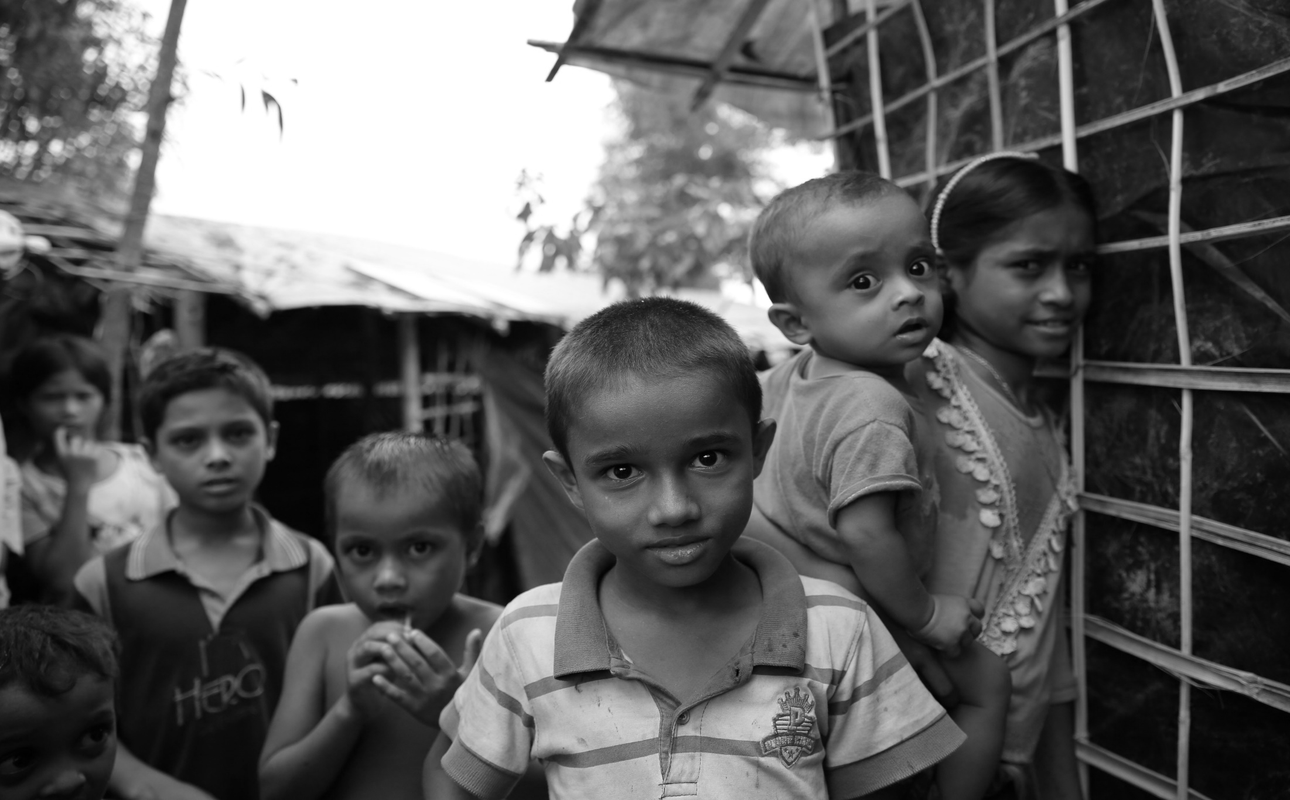
A child is a child, before being a migrant. That means the child has to be integrated in child protection systems as soon as possible, and not be considered only as a migrant person

Slide 19
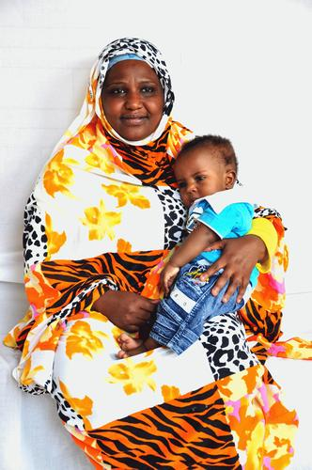
Migrant Women- Global statistics 2020
281 million migrants globally in 2020
135 million international female migrants globally in 2020, or 3.5 per cent of the world’s female population
48% of International migrants population in 2020 were women

Slide 20
Gender dimensions of migration
The experiences men and women have as migrants differ, and most of the differences are due to the role, behaviour, and relationships that society assigns to, and expects from, a woman or a man in a country of origin and a country of destination
Migration impacts differently on men and women, and on different groups of men and women in their process of movement as well as on their reasons to migrate and the challenges they finally face
Gender also shapes migrants’ experiences

Slide 21
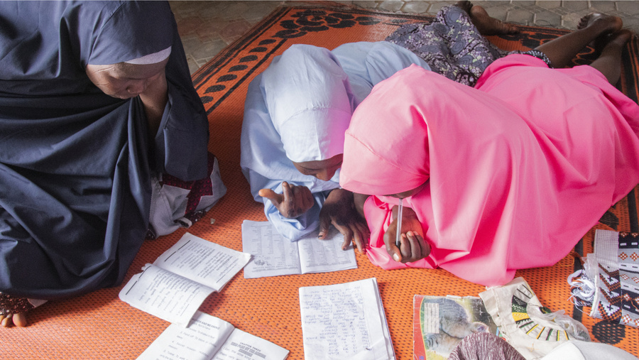
Specific human rights concerns related to migrant women
Discrimination
Sexual and gender based violence
Access to decent work and social protection
Migration and access to health care, including sexual and reproductive health, and education
Access to education
Access to justice for migrant women and girls
Access to information

Slide 22
Rights of Migrant Women
Inherently, all human beings are entitled to all human rights.
  rights are universal, inalienable, indivisible, interdependent and of equal importance.
International human rights law
  every person enjoy his or her rights without discrimination, including on the basis of sex or other status.
Discrimination based on sex is prohibited is prohibited under almost every human rights treaty

Slide 23
Convention on the Elimination of All Forms of Discrimination against Women (CEDAW)
189 States parties to the Convention
dedicated to the realization of women’s human rights.
  designed to promote and protect women’s rights – socio-economic, civil and political – in both the public and private spheres.
Considered the international bill of rights for women,
defines what constitutes discrimination against women and sets an agenda for national action to end such discrimination

Slide 24
CEDAW and Migration
Specific rights with respect to migrant women
  obligations to suppress trafficking in women (art. 6);
  grant women equal rights with men to acquire, change or retain nationality (art. 9);
  eliminate discrimination against women in the field of employment (art. 11);
  eliminate discrimination against women in the field of health care and ensure access to health-care services, including those related to family planning and maternal care (art. 12); and
  accord to men and women the same rights with regard to the law relating to the movement of persons and the freedom to choose their residence and domicile (art. 15 (4)).

Slide 25
Rights of migrant women: CEDAW General recommendations
CEDAW General Recommendation No. 26 on women migrant workers
CEDAW addressed the issues of women migrant workers :
  Who travel independently,
  who migrate as dependants of their spouses and
  Who are in irregular situations.
Ensuring that women migrants workers are protected throughout the migration cycle
It outlined a set of responsibilities that should be assumed by States, including:
  implementing gender-responsive and rights-based migration policies,
  involve women in policymaking,
  Ensure that the legal framework, provide to women migrant workers the same rights that are extended to all workers in the country, including key labour and social protections.
  Enforce access to justice for women migrant workers, including redress for human rights violations at all stages of the migration cycle
  safeguarding remittances sent by women migrant workers,
  collecting data disaggregated by gender, and
  lifting discriminatory bans on women’s freedom of movement.

Slide 26
Rights of migrant women: CEDAW General recommendations
General recommendation No. 38 (2020) on trafficking in women and girls in the context of global migration
underlines the conditions created by restrictive migration and asylum regimes as one of the factors that push migrants towards irregular pathways
Recommendations
Establish a gender-responsive and safe migration framework to protect migrant women and girls, including those with an irregular migration status, from violations of their human rights at every stage of migration
  increased access to pathways for safe and regular migration to avoid exploitation
  gender analysis to all migration policies and programmes,
  Increasing access to family reunification
  Rights of children: consider unaccompanied girls as especially vulnerable and requiring additional protection
Provide accurate information, about rights and the means of and reasons for avoiding human traffickers
Incorporating gender-sensitivity and trauma-sensitivity
  Specifically in arrangements for arrivals at all borders (appropriate reception facilities and services)
  Training for individuals tasked with providing assistance and protection services for Victims of trafficking or exploitation
For women migrant workers:
  Introduce, strengthen and enforce employment legislation to protect women migrant workers irrespective of their documentation status, and provide protections, (specifically in unregulated, informal or unmonitored economic sectors that rely on migrant labour)
  Establish mechanisms in the country of destination to address violations of the rights of women migrant workers during employment
  Mitigate the risks of dependency and vulnerability of women migrant workers in relation to their employers,
independent attainment of official identification and travel documents without requiring them to obtain permission from a spouse or male guardian

Slide 27
Rights of migrant women: CEDAW General recommendations
General recommendation No. 30 on women in conflict prevention, conflict and post-conflict situations
Conflict situations closely linked to crises of internal displacement, statelessness and the struggle of refugee populations
  Trafficking may also occur when third-party countries restrict migration out of conflict-affected areas through measures (interdiction, expulsion or detention)
  Conflict can also be both a cause and a consequence of statelessness
Recommends:
Protection and prevention of gender based violence, including in camps , settlements and camp like settings
Ensure women’s access to justice; equal access to services and health care
Promote the meaningful inclusion and participation of internally displaced and refugee women in all decision-making processes,
Adopt a comprehensive gender-sensitive and rights-based migration policy that ensures that women and girls coming from conflict-affected areas are not subject to trafficking
Protection of the human rights of displaced women and girls, including access to basic services, during flight, displacement and in the context of durable solutions
Equal rights to obtain documents necessary for the exercise of their legal rights
  right to have such documentation issued in their own names, (Ensure individual documentation)
  prompt issuance or replacement of documents without imposing unreasonable conditions
  the timely and equal registration of all births, marriages and divorces.

Slide 28
Rights of migrant women: CEDAW General recommendations
General recommendation No. 32 on the gender-related dimensions of refugee status, asylum, nationality and statelessness of women
Obligation of States parties to treat women with dignity and to respect, protect and fulfil their rights under the Convention at each stage of the displacement cycle, and in durable solutions
Recommendations
ensure equality of women and men with regard to the acquisition, changing and retention of nationality and to enable women to transmit their nationality to their children and to their foreign spouses
Repeal laws stipulating the automatic acquisition or loss of women’s nationality as a result of changes in the marital status or nationality of her husband
institute gender-sensitive procedural safeguards in asylum procedures to ensure that women asylum seekers are able to present their cases on the basis of equality and non-discrimination.
CEDAW General Comment No. 21: Equality in Marriage and Family Relations
Migrant women who live and work temporarily in another country should be permitted the same rights as men to have their spouses, partners and children join them.

Slide 29
Rights of women migrants- International law
Convention on the Rights of the Child
The principle of non-discrimination is codified in article 2 of the Convention on the Rights of the Child .
Joint general comment No. 3 (2017) of the Committee on the Protection of the Rights of All Migrant Workers and Members of Their Families and No. 22 (2017) of the Committee on the Rights of the Child
  States parties should respect and ensure the rights set forth in the Convention for all children, whether they are considered, inter alia, migrants in regular or irregular situations, asylum seekers, refugees, stateless or victims of trafficking, including in situations of return or deportation to their country of origin, irrespective of their or their parents’ or legal guardians’ nationality, migration status or statelessness
International Convention on the Protection of the Rights of All Migrant Workers and Members of Their Families
provides for the rights of migrant workers and their families without discrimination based on sex.
General comment No. 1 (2011) on domestic migrant workers
  promotion and protection of the rights of domestic workers at all stages, decent work for them, and proper regulation of that work in national labour legislation, so as to ensure that domestic workers enjoy the same level of protection as other workers and have effective access to justice and remedies
Several International Labour Organization (ILO) Conventions complement the protection of women migrant workers’ rights.
Specifically, the Domestic Workers Convention (No. 189) (2011),
a fundamental tool which guaranteeing the rights of female nationals as well as migrant women
who are employed as domestic workers.

Slide 30
SDG’s and Women Migrants: 2030 Agenda for Sustainable Development
“leave no one behind” and to “reach those furthest behind first” and with the goal of reducing inequalities
The 2030 Agenda acknowledges that international migration is essential for the development of countries of origin, transit and destination and also highlights the linkage between gender and migration.
Goal 5 on gender equality and women and girls’ empowerment;
  target 5.4 aims to promote and value unpaid domestic work
  Indicator 5.1.1, measures whether legal frameworks exist that promote and monitor equality and non-discrimination on the basis of sex,
  indicator 5.4.1 measures the proportion of time spent carrying out unpaid domestic work disaggregated by sex, age and location.
Goal 8 on growth and decent work;
  SDG 8.8 on decent work for all, world leaders committed to: Protect labour rights and promote safe and secure working environments for all workers, including migrant workers, particularly women migrants, and those in precarious employment
Goal 10 on reducing inequalities;
  SDG 10.7 aims to: Facilitate orderly, safe, regular and responsible migration and mobility of people, including through the implementation of planned and well-managed migration policies

Slide 31
Global Compact for Safe, Orderly and Regular Migration (GCM) and Women Migrants
Gender responsiveness : GCM guiding principle
Ensure that the human rights of women, men, girls and boys are respected at all stages of migration
Ensure their specific needs and contributions are properly understood and addressed
Ensure that they are recognized and empowered as agents of change
Mainstream a gender perspective and promote gender equality and the empowerment of women and girls
Recognize migrant women’s independence, agency and leadership, and move away from addressing migrant women primarily through a lens of victimhood.

Slide 32
Statelessness
Definition : A person who is not considered as a national by any State under the operation of its law.
Source: United Nations Convention relating to the Status of Stateless Persons ((adopted 28 September 1954, entered into force 6 June 1960) 360 UNTS 117) Art. 1.
Fundamental right to nationality:
  The Universal Declaration of Human Rights affirms that “everyone has the right to a nationality”
  Convention on the Nationality of Married Women (1957), CEDAW (Article 9) and CRC (Articles 7 and 8); CERD (Article 5)
People usually acquire a nationality
  automatically at birth, either through their parents or the country in which they were born.
  In some cases, a person must apply to become a national of a country.
Reasons for Statelessness
  discrimination (e.g., on the basis of gender, ethnicity, religion),
  conflicts between and gaps in nationality laws,
  lack of birth registration
  State succession.

Slide 33
International Legal Framework and Policy Initiatives
The 1954 Convention relating to the Status of Stateless Persons and
The 1961 Convention on the Reduction of Statelessness.
the only international treaty aimed specifically at regulating the standards of treatment for stateless persons-provides a core set of principles for their treatment.
seeks to ensure that stateless people enjoy a minimum set of rights.
ensures that stateless persons enjoy human rights without discrimination. It provides stateless individuals with an internationally recognized legal status, offers them access to travel documents, identity papers and other basic forms of documentation, etc.
a comprehensive set of tools for eradicating statelessness
aims to prevent statelessness and reduce it over time.
It requires that states establish safeguards in their nationality laws to prevent statelessness at birth and later in life.
the most important provision of the convention establishes that children are to acquire the nationality of the country in which they are born if they do not acquire any other nationality.

Slide 34
Minimum standards of treatment for stateless people
All rights under International human rights law complements the provisions of the 1954 Convention, to provide protection to stateless persons
The 1954 Convention establishes minimum standards of treatment for stateless people. Rights include,
  the right to education,
  To employment
  To housing
  Access to justice (due process, access to courts)
  Right to freedom of movements
  a right to identity, travel documents and administrative assistance.
For most rights enumerated under the 1954 Convention, stateless persons should enjoy at least the same rights guaranteed to other non-nationals.

Slide 35
Statelessness- Responsibility of States
State’s have the responsibility to respect , protect and fulfill the human rights of all within its territory
The 1954 Convention does not establish a right for stateless persons to acquire the nationality of a specific State.
  However, in practice, there may be no possibility of return to the country of former habitual residence of the individual concerned or there may be no such country.
  States are also bound by the prohibition of refoulement as a principle of international law
    may not return a stateless person to a territory where he or she would be at risk of persecution or breaches of other fundamental international human rights standards, including torture and arbitrary deprivation of life
  States Parties to facilitate the integration and naturalization of stateless persons as far as possible, for example by expediting and reducing the costs of naturalization proceedings for stateless persons.

Slide 36
Nexus between migration and statelessness
Although most stateless people are not migrants, there is an important nexus between migration and statelessness.
reflected in recent international processes such as the Sustainable Development Goals and the Global Compact for Migration, which push for the issue of statelessness and legal identity to be resolved by States along with migration matters.

Slide 37
Nexus between migration and statelessness
Sustainable Development Goals
GCM
SDG 16:Promote peaceful and sustainable societies for sustainable development, provide access to justice for all, and build effective, accountable and inclusive institutions for all
Calls upon States to provide legal identity for all, including birth registration
Target 16.9: By 2030, provide legal identity for all, including birth registration.
OBJECTIVE 4: Ensure that all migrants have proof of legal identity and adequate documentation
Strengthen measures to reduce statelessness, including by registering migrants’ births, ensuring that women and men can equally confer their nationality to their children, and providing nationality to children born in another State’s territory, especially in situations where a child would otherwise be stateless, fully respecting the human right to a nationality and in accordance with national legislation

Slide 38

UNHCR mandate
Per UN General Assembly Resolutions, UNHCR is charged with performing the functions regarding assistance to stateless persons set forth in Article 11 of the 1961 Convention.

Slide 39
CASE STUDY
Case study 1 | Case study 2 | Case study 3
Tanya is 12 years old. She lives in a border town in State A. Due to violence there, she escaped to State B with her family. On the way she was separated from her parents. She walked with a large group of people and came to a camp in State B, that was opened to receive people fleeing the violence. She has been living in the camp for 6 months and is yet to find her family and has not been to school. | Maria has been working in State A as an agricultural worker. Maria worked at a farm with 15 other migrant workers, some who are also undocumented . They have not been paid for several months and when Maria went to her employer to ask for her payment, she was told to continue working or leave the farm. She fears that if she leave the farm, she will not find alternate employment or housing. Maria previously worked as a domestic worker and was abused. She left the job , but her documents are still with her previous employer. Maria fears that if she goes to the authorities she will be detained and deported. | Kris was born in State A and holds a birth certificate, passport and voter’s card from State A. He states that both his mother and father are from State A. In 2022, Kris approached authorities in State A , to process his marriage application. However, the local government office launched an investigation into his citizenship. The government claimed that based on the investigation it appeared that Kris’s father was not a citizen of State A but migrated from neighbouring State B and has been irregularly living in State A. In State A , one gets the nationality of one’s father. The authorities concluded from the investigation that Kris was not a citizen and that he obtained his documents fraudulently. Kris was deported to State B, where he was arrested and convicted of being unlawfully present. Since his conviction, he lives in a no man’s land at the State A and State B border. He is not recognized as a citizen of State A or State B , the only two states with which he has a possible material link.
What are the rights available to Tanya in this situation? Which regional or international human rights instruments are applicable in her case? | What rights have been violated in this case? What are the protections available to Maria? | What are the rights available to Kris? What are the violations of international law that is being committed ?

Slide 40
Thanks for your attention
& participation!
Any questions?

