Slide 1
Improving international mechanisms of protecting the rights of stateless persons and migrant workers.
(The case of Uzbekistan).
Nayimov Otabek Mardonovich
PhD in Political Science
University of World Economy and Diplomacy
Tashkent, Uzbekistan

Slide 2
Statelessness in Central Asia: General overview
Statelessness in Uzbekistan
Definitional challenges of statelessness
Reduction of statelessness in Uzbekistan
Protecting the rights of migrant workers in Uzbekistan: Legal and practical mechanisms
The Analysis of Labor Migration of Uzbekistan
Outline of Presentation

Slide 3
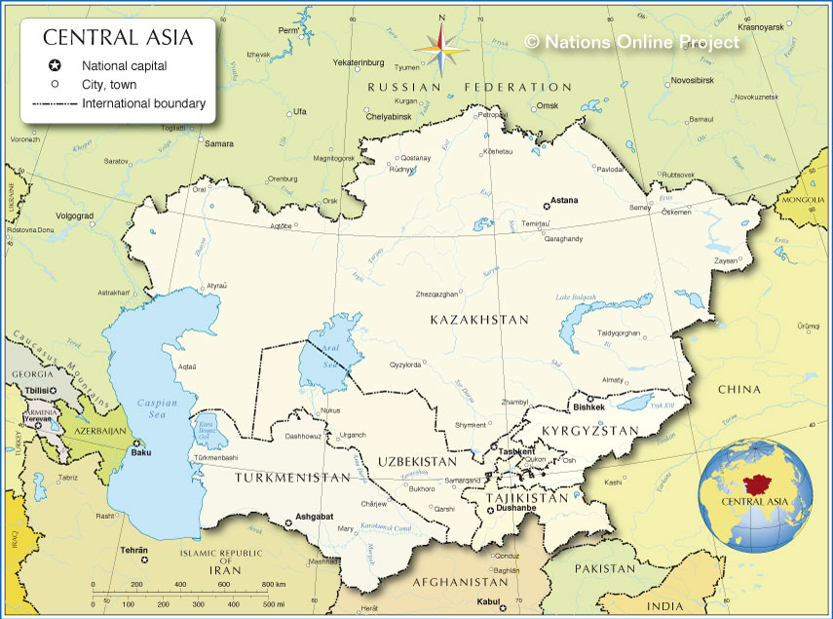

Slide 4
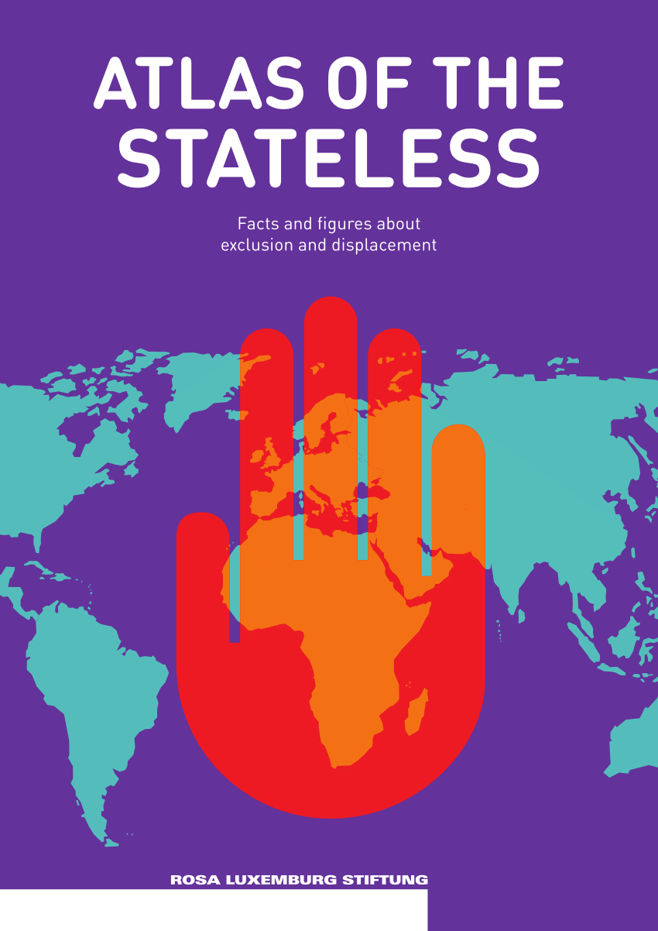
Statelessness in Central Asia
Root causes of statelessness in Central Asia:
- The collapse of the Soviet Union. Post-Soviet border demarcations also created many stateless persons;
- A return to the historic or ethnic homelands;
- Labor migrants;
- Afghan refugees settled in Central Asian states in early 1990-x.
- Gaps in nationality laws, mixed marriages…
The great majority of Central Asian stateless persons originate from within the Central Asia itself.

Slide 5

Statelessness in Central Asia
Central Asia is making great progress in tackling the statelessness over the last years
In 2019, Kyrgyzstan became the first country in the world to resolve all statelessness in
its territory. The global hope is that the Kyrgyz example will be replicated
throughout the world as part of #IBELONG campaign launched by UNHCR in 2014
Of all 5 Central Asian states, only Turkmenistan is a party to the 1954 Convention
relating to the Status of Stateless Persons. From 2005 to 2015, Turkmenistan
granted citizenship to 21 000 refugees and stateless persons
UNHCR supports the States’ efforts to develop safeguards against statelessness at
birth, apply the universal definition of a stateless person, and establish
statelessness determination procedures in line with the international standards

Slide 6
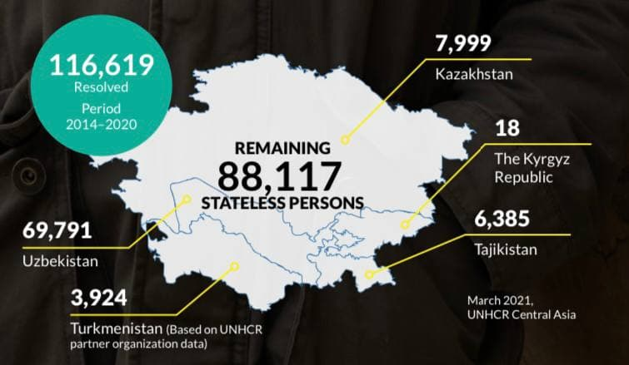

Slide 7
CUMULATIVE FIGURES OF PERSONS IN STATELESSNESS SITUATION
Period: Since the start of the #Belong Campaign in 2014 and through 31 December 2020
 |  | Kazahstan | The Kyrgyz Republic | Tajikistan | Turkmenistan | Uzbekistan | Total
Stateless persons | I | 18,497 | 135 | 1,878 | 3,459¹ | 108,535³ | 132,504
 | R | 9,811 | 132 | 79 | 7,614² | 38,744⁴ | 56,380
Individuals of Undetermined Nationality | I | 6,556 | 13,572 | 48,943 | 2,136¹ | NA | 71,207
 | R | 2,030 | 13,557 | 44,425 | 227
 | R | 2,030 | 13,557 | 44,425 | 227 |  | 60,239
IDENTIFIED
RESOLVED
Identification exercise undertaken by the joint work
Of UNHCR, partners and governmental counterparts
The authorities grant
nationality to the individual
1
2
3
4
Based on partner organization data
Number of naturalized stateless persons by the Governmental of Turkmenistan
Statistical data as of November 2020 reported by the Government of Uzbekistan in January 2021
Number of naturalized persons by the Governmental of Uzbekistan

Slide 8
Statelessness in Uzbekistan
Uzbekistan is a country with the largest number of stateless persons in Central Asia
New mechanisms of tackling the issues of statelessness in Uzbekistan
Major changes in the reduction of statelessness in Uzbekistan over the last years:
-In support of the call of the UN Secretary-General for strong measures to reduce the
number of stateless persons, 50 000 people granted Uzbek citizenship in 2020.
-In the Presidential elections on 24 October 2021, more that 22 000 citizens of Uzbekistan,
for the first time have realized their right to vote as a result of obtaining Uzbek citizenship.
-Uzbekistan’s commitment made at the 46th Session of the UN Human Rights Council.

Slide 9
Definitional challenges of statelessness
Article 3 of the law of Uzbekistan ‘On Citizenship of the Republic of Uzbekistan’ of February 2020 defines a stateless person as “a person who permanently resides in the territory of the Republic of Uzbekistan, is not a citizen of Uzbekistan and does not have evidence of his belonging to the citizenship of a foreign state”.
It is different from the definition of the stateless person found in Article 1 of the 1954 Convention on the Status of Stateless Persons, which defines a stateless person as “a person who is not considered as a national by any State under the operation of its law.
Main differences in these two definitions of stateless persons are:
a. international definition doesn’t require that the person is permanently residing in the state that recognizes his or her
statelessness
b. the international definition is less rooted in the issue of evidence
c. Uzbek definition does not capture the universality of the international definition of stateless persons
d. definition of stateless person as currently embedded in the Citizenship Law of Uzbekistan most likely not include
someone who is stateless outside of Uzbekistan, if such a person lacks a permanent residence status in Uzb.n.
Thus, someone who is stateless in Kazakhstan or Russia is not necessarily stateless according to the Citizenship
Law of Uzbekistan, which requires permanent residence.

Slide 10
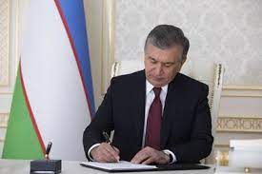
Reduction of statelessness in Uzbekistan
Uzbekistan has made great progress in reducing the number of stateless persons and gradually enabling access to citizenship for its stateless persons in its territory
The passing of a new citizenship law in Uzbekistan in 2020 would grant an estimated 50 000 stateless people to acquire citizenship of Uzbekistan, namely those who settled in Uzbekistan before 1995¹
Furthermore, next round of amendments aims to provide access to citizenship for all stateless persons who granted permanent residence before 2005, which is estimated to bring citizenship to 20 000 stateless persons, thus resolving roughly 70 000 statelessness cases in total in just a few years
Their children will also be eligible to citizenship through the same process under this new citizenship law
Mirziyoyev signs Legal status of foreign citizens
and stateless persons in Uzbekistan Bill into Law –
Tashkent Times

Slide 11
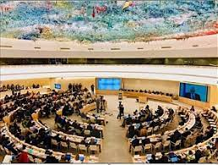
New Citizenship Law of Uzbekistan also includes other important provisions to prevent statelessness and introduces, for the first time, simplified naturalization procedures.
Uzbekistan amended its birth registration practices to ensure universal birth registration, including for children born to undocumented parents and also launched to identify and register all cases of unregistered births
UNHCR has applauded these developments by stating that ‘Uzbekistan has made significant progress in resolving and preventing statelessness in recent years and this development is huge leap forward in ending known cases of statelessness. Tens of thousands of people now have the opportunity to belong.”
In October 2020, Uzbekistan elected UN Human Rights Council for the first time in its history for the period 2021-2023. It also clearly demonstrates Uzbekistan’s commitment to reform process as well as its readiness to protect human rights.
Uzbekistan elected to UN Human Rights Council for the period 2021-2023

Slide 12
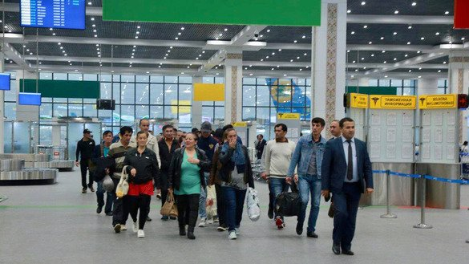
Protecting the rights of migrant workers in Uzbekistan: Legal and practical mechanisms
Due to economic difficulties and lack of work places in Uzbekistan, migration to Kazakhstan, Russia, Turkey, the UAE, the Republic of Korea, and European countries are increasing over the last years
Thus, ensuring the better protection of the rights of migrant workers is becoming more urgent than ever before
Uzbekistan has been steadily improving the legal protection of its migrant workers and closely cooperating with main states where Uzbek migrants traditionally go to work
Basic legal acts in the field of foreign labor market adopted in 2018-2020, 12 key documents, such as the Law of Uzbekistan on Labor Migration is approved by Uzbek Parlilament, Presidential decree on Measures to Introduce a System of Safe, Orderly and Regular Labor Migration as well as several other legal acts

Slide 13
Major improvements
One of major direction of Uzbekistan’s policy towards regulating safe and regular migration is establishing closer relations with government and non-government institutions regulating migration
The Agency for Labor Migration of Uzbekistan opened its representative offices in Gwangju (South Korea) and in Moscow and Saint Petersburg (Russia)
In 2020, Safe, Orderly and Regular labor migration system is introduced in Uzbekistan
As part of a ‘Labor Migration’ program launched by the Ministry of Labor of Uzbekistan, several key courses opened aimed at improving the qualifications of labor migrants, their linguistic skills in Russian, English, Turkish, Korean, as well as up to 15 centers identifying and offering jobs in foreign countries.
Nowadays, 59-centers for learning new professions and improving professional qualifications are working throughout Uzbekistan
Several other social protection measures of migrant workers are also put in place, such as discount of train and plane tickets, assistance in obtaining work visa, material assistance for those in need in times of pandemic and etc.

Slide 14
The Analysis of Labor Migration of Uzbekistan
According to the Ministry of Internal Affairs of Uzbekistan, the number of labor migrants working in foreign countries is 2.1 million people as of 1 December 2021
Countries that Uzbek migrants work in their majority are Russia (1,3 million), Kazakhstan (400 thousand), Turkey (67 thousand) and South Korea (40 thousand) people
Uzbek migrants work: 51-percent in construction, 10-percent in trade and services, 10-percent in agricultural sector, 9-percent in industry, and 20-percent in other sectors
In 2021, up to 110 thousand migrant sent to temporary work to Russia (100 260), Kazakhstan (6924), South Korea (1 532), Saudi Arabia (145), Bulgaria (121), Lithuania (57), Latvia (25), UAE (21), Oman (20), Qatar (19), Ukraine (10), Slovakia (8), Germany (4), Azerbaijan, Israel, Turkey, and Poland by (2).
The scope and geography of migrants going to temporary work is also increasing.

Slide 15
Thank you very much!

