Slide 1
Displacement and human trafficking

Slide 2
Trafficking in Persons
International definition established by the United Nations Protocol to Prevent, Suppress and Punish Trafficking in Persons, especially women and girls
  Defined as an act (recruitment, transportation, harbouring, transfer or receipt of persons) using an improper means (deception, force, threats, etc.) for the purposes of exploitation (including sexual, labour, organ removal, etc.)
Has been criminalized in most countries around the world
Key notes: affects all ages and genders
Risk factors at various levels that increase vulnerability to trafficking

Slide 3
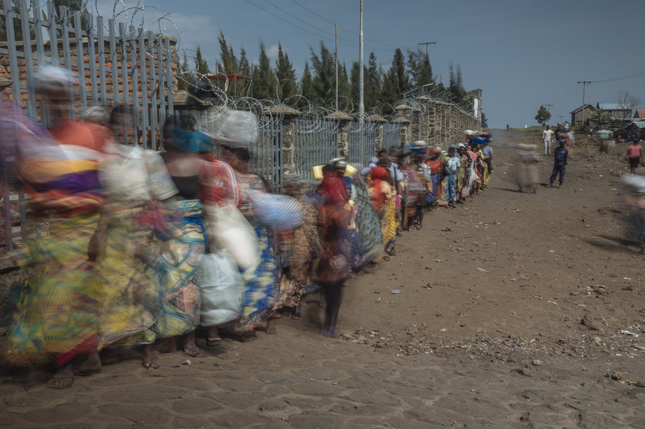
Emergency / Crisis / Humanitarian Settings
What constitutes an emergency and why differentiate from ‘stable’ settings, in relation to counter trafficking?
  Identification may be more difficult
  Our response has to be adapted
Increasing awareness of TIP among humanitarian actors, but often overlooked
UN SCRs 2331 (2016) and 2338 (2017) focus explicitly on TIP in armed conflict and call upon States and humanitarian actors to respond.
Photo credit: IOM photo library; approved
Annual SG report on children and armed conflict (SCR 1612), and on CRSV can result in punitive action against States: sanctions, asset freezes, indictments.
Notes:
For this discussion we tend to use ‘emergency’, ‘crisis’, and ‘humanitarian’ setting interchangeably, but what do we mean by this?
What are some examples of emergency situations?
[Aim for responses: earthquake, drought (and subsequent food insecurity), tsunami, hurricane, flood, armed conflict, protracted instability…. What about economic crisis? (ie. Venezuela). What about disease outbreak? (ie. Ebola)]
The common feature is typically displacement. And it is usually abrupt, large-scale, and accompanied by decreased ability of the State to respond.
What about a pandemic? (ie. COVID) Can we include COVID in this list, if the entire world is affected and there is no geographic or physical focus? [Open-ended question, no perfect answer].
There is no clear criteria for ‘emergency contexts’ and while not all humanitarian crises require displacement, necessarily, for the purpose of this session we will envision emergency contexts as having the element of significant population displacement in response to a crisis – either internal or cross-border. Recall that this could also apply to returns, especially if they are in large numbers, forced returns, and the response is overwhelmed.

Slide 4
Displacement, crises, and vulnerability
How are crisis-affected populations more, or newly vulnerable to trafficking and exploitation?
Displacement may hinder State’s protection capacity
State may be unable or unwilling to protect people from harm, leading to displacement
Displacement interrupts existing protective networks and exhausts coping strategies
Some crises, ie. armed conflict, bring specific risks & can lead to TIP (including):
- abduction or recruitment into armed groups
- sexual exploitation or sexual slavery
- labour exploitation
- forced criminality, extortion, and organ/tissue removal
Notes:
[Ask]: how might displacement affect vulnerability to trafficking and exploitation for an individual, household, and/or general population?
[Spend time here; aim to draw out responses like: loss or disruption of community and family network, loss of livelihood, loss of property, separation from family members, trauma, illness, compounded physical or psychological injury, new or worsened poverty, immobility or confinement to camp settings, curfews, dependency on humanitarian assistance, exclusion from work force, poor living conditions (in camps or urban settings), pressure to meet household demands, proximity to conflict or armed groups, weak rule of law or absence of State intervention, usual support services could be overwhelmed, closed, destroyed….]

Slide 5
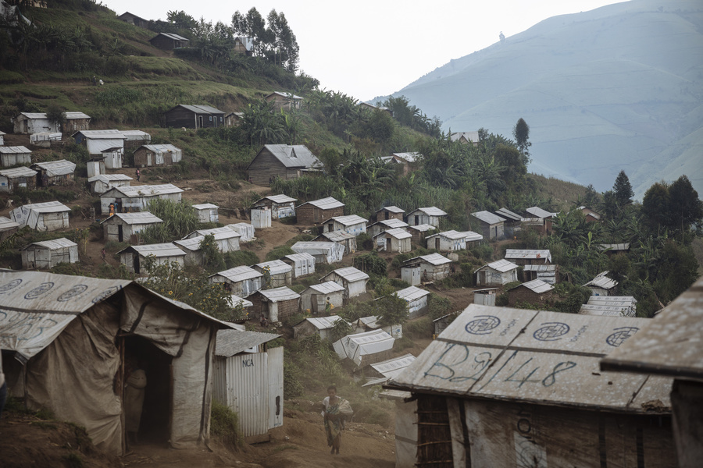
Examples of TIP observed in emergencies
Forced labour, servitude, debt bondage
Child labour including recruitment into armed groups
Sexual exploitation: sexual slavery or marriage into armed groups; prostitution; child sexual exploitation; sexual arrangements with security forces or humanitarian actors
Trafficking for organ or tissue removal
Forced/temporary/child marriage
Photo credit: IOM photo library; approved
Notes:
People often question – what does trafficking look like in an emergency - what are some examples?
This slide has a non-exhaustive list of examples of TIP that have been observed in different emergency settings and were largely attributed to occurring because of the crisis situation, not simply parallel to it, or pre-existing.

Slide 6
Emergency Response Systems
The type of displacement can determine the type of response
Refugee Coordination Model (RCM): cross-border involving refugees and asylum-seekers.
    Led by UNHCR. Framework = Refugee Response Plan (RRP)
Inter-Agency Standing Committee (IASC) Cluster System: internal displacement.
    Led by OCHA. Framework = Humanitarian Response Plan (HRP)
Mixed RCM and IASC Cluster: cross-border and internally displaced.
    Parallel RCM and IASC Cluster Response, each focusing on their respective populations. Frameworks = RRP and HRP.
No clear movement type or response model: mixed flows, often regional dimension with political complexities.
    Migrant Refugee Response Platform (MRRP), co-led by IOM and UNHCR
*Recall: authority and responsibility still lies with the State.
*Recall: national NGOs are often the first to respond and have a critical role.
*Recall: migrants of varying profile can be among all of these displaced populations.
Notes:
Recall: the authority and responsibility to respond rests with the State, though in crisis contexts they may be unable or unwilling to intervene.
National or local NGOs and response mechanisms often exist and these should be supported where possible; however they may also be overwhelmed or incapacitated.
Parallel to these humanitarian response structures, there could very well be a UN Political Assistance Mission, UN Peacekeeping Mission or other multi-national military response such as NATO, African Union, or a combination. It is normal to live and work alongside these security actors and while their mandates are significantly different than that of humanitarian workers, by and large we do typically share an underlying goal of protecting civilians. These security forces do have relevance to counter trafficking work, both as observers of potential violations, and as potential offenders themselves.

Slide 7
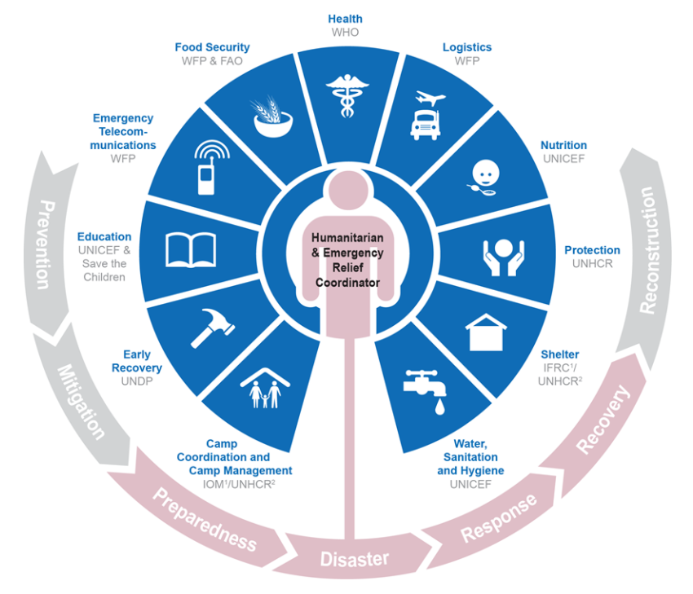
Clusters and Coordination
Graphic: UN OCHA
A sector-based system of coordination
Each cluster is led by a UN Agency and co-led by a UN Agency or International NGO
Counter trafficking work falls logically within the Protection Cluster
Multi-agency clusters meet regularly and agree on the best division of activities
Clusters should involve national actors and, when appropriate, government
Recall that the ultimate aim is to support national capacity to respond - clusters are time-bound and not meant to replace government capacity for the long-term
Notes:
History: the Cluster Coordination system was motivated by the 2004 Asian Tsunami and the chaotic experience of duplication and saturation of relief organizations.
Cluster system was first applied in 2005 in the Pakistan earthquake.
Recall that the ultimate aim is to support national capacity to respond, and eventually phase out the international response.
Clusters are seen as time-bound and are not intended to last indefinitely nor replace State structures.
In protracted situations, clusters do run the risk of replacing the work of government or local services, which can arguably delay true accountability and transition to stable contexts.

Slide 8
Detecting, identifying, referring cases of TIP
The role of front-line humanitarian/ protection workers in identifying and addressing cases of TIP:
Existing & routine monitoring: observe trends, population movements, household dynamics, community dynamics, gather information on protection concerns and economic problems, and notice questionable health conditions
Not necessary to establish new systems of data collection, reporting, or communicating with the affected population
Guidance and training on understanding TIP for front-line actors: Protection, CCCM, Health, and Education in particular
The question of referral – to whom? Is referral possible, and safe?
Notes:
Recall: Humanitarian workers are not expected to seek out victims of trafficking, investigate suspicious cases, or verify cases through a formal assessment.
Humanitarian workers are in a position to notice trends, observe questionable household demographics and activities, observe population movements, and be aware of injuries or health conditions through routine front-line monitoring.

Slide 9
Risk assessment and reporting
How to assess CT-related security concerns in emergency contexts?
Who are the perpetrators of TIP? Are they always dangerous? What dangers do they pose?
What are the risks in assisting (potential) victims of trafficking?
What are the considerations for reporting individual cases or even broader trends of TIP? Is it best to avoid reporting?
Importance of Do No Harm
Notes:
Bullet 1 Answer: TIP could be perpetrated by highly organized criminal networks, or much less organized groups of opportunists, as well as community members, neighbours, family members, or peers including other children. Those who are involved indirectly or are complicit also have a stake in the system and may react if trafficking is disrupted.
Bullet 2 Answer: possible risks are similar to risks in any ‘stable’ or non-emergency environment and can include retaliation (physical, verbal, reputational) towards anyone involved; punishment or following through with threats towards the trafficked person or their family; disappearance of the victim; aggression towards the organization providing support and/or the entire humanitarian community; blocked access to the affected population; complications with the relationship to the host government, to name some.
Bullet 3 Answer: considerations prior to reporting include the capacity of the receiver of the information to respond; the support services that may or may not be in place; confidence in the quality of confidentiality and data protection; capacity to protect the victim and those making the report; possibilities of mandatory reporting (when the receiver of information is legally obligated to report onwards whether there is consent to do so or not); mandatory cooperation with authorities in order to receive assistance.
Bullet 4 Answer: This does not mean that cases of TIP should be ignored or go unreported. It means that the entire context, operating environment, and status of activities and relationships at the highest level of UN representation need to be incorporated. This is where engagement through the Protection to the Humanitarian Coordinator, or through a head of agency to the Humanitarian Coordinator is important.

Slide 10

Instruments, Principles, and IOM’s role
Standards and guidelines (including principles)
    IOM Handbook on Direct Assistance for Victims of Trafficking
    Caring for Trafficked Persons: Guidance for Health Providers
    IOM Handbook on Protection and Assistance for Migrants Vulnerable to Violence, Exploitation and Abuse
    IOM Guidance on Response Planning
    IOM Guidance on Referral Mechanisms
    An Introductory Guide to Anti-Trafficking Action in Internal Displacement Contexts
    Counter-trafficking in Emergencies: Information Management Guides
    Case management guidelines (forthcoming)
    Vulnerability assessment guidance (forthcoming)

Slide 11
Instruments, Principles, and IOM’s role
Operational tools
    Victim of trafficking screening forms
    Migrants vulnerable to violence, exploitation and abuse screening forms
    Rapid screening forms
    Counter Trafficking Data Collaborative
Role
    Technical assistance and capacity development
    Programming: 3Ps, humanitarian protection, etc.
    Case management
    Data and research

Slide 12
Recap – key messages
Human trafficking does occur before, during, and after humanitarian emergencies, and can increase because of the crisis
The primary responsibility to protect still lies with the State, even in emergency contexts where the rule of law may be weak or State functions have broken down
Under the Centrality of Protection, humanitarian actors are in a position to detect, identify, refer and assist cases, and to prevent further situations of trafficking within existing emergency response mechanisms
Protection actors may have established systems for: identifying beneficiaries, determining support needs, providing protection and making referrals during emergencies – CT activities can be integrated within these, avoiding new or parallel systems

Slide 13
Thank you!
Heather KOMENDA
Senior Regional Thematic Specialist
Migrant Protection
IOM Regional Office Vienna

