Slide 1


Introduction to International Migration Law
Gianna Sanchez Moretti (Doctor in Law)
International Migration Law Officer
International Migration Law Unit (IML)
IOM, HQ

Slide 2
Learning Objectives
By the end of this session, you will be able to:
1. Name the branches of International Migration Law (IML) and identify key instruments under each. | 2. Describe the key legal principles, rights and the migrant populations these instruments aim to protect.
3. Describe the actors and their roles in implementing IML. | 4. Identify and apply the human rights of migrants and IML principles in different cases.

Slide 3
CHAT
What is International Migration Law (IML)?

Slide 4
POLL
Who are the subjects of public international law?
States
International organizations
Individuals
Groups
NGOs
Business
All of the above
None of the above

Slide 5
POLL
Is the International Covenant on Economic, Social and Cultural Rights a legally-binding international instrument?
yes
no

Slide 6
POLL
Is the Global Compact for Safe, Orderly and Regular Migration a legally-binding international instrument?
yes
no

Slide 7
POLL
Which branch of law belongs to IML?
Humanitarian Law
Human Rights Law
Transnational Criminal Law
Refugee Law
Labour Law
Law of the Sea
Aviation Law
None
All of them

Slide 8
Relevant Branches of IML
NATIONALITY LAW
LABOUR
LAW
HUMAN RIGHTS LAW
LAW OF
THE SEA
CRIMINAL LAW
CONSULAR AND DIPLOMATIC LAW
HUMANITARIAN
LAW
REFUGEE LAW
Notes:
IML is an umbrella term which comprises both general and specific legal norms that apply to the movement of persons across borders. It could be thought of as a “jigsaw puzzle”.
IML is an attempt to provide a systemic integration of the broad variety and number of rules governing the movement of persons across borders. Some scholars believe that IML is still a work in progress.
Here is an illustrative list of the main branches of international law that make up IML:
International human rights law
International statelessness law
International labour law
International humanitarian law
Law of the sea
International/transnational criminal law
Consular and diplomatic law
International refugee law
In addition to customary international law rules, each of these branches making up international law are built on some core instruments. The following slides will refer to the main ones with universal application and is thus without prejudice to relevant regional instruments.

Slide 9

International Human Rights Law
1948
Universal Declaration of Human Rights
1965
International Convention on the Elimination of All Forms of Racial Discrimination (CERD)
1966 (2)
International Covenant on Civil and Political Rights + 2 OPs (HRC)
International Covenant on Economic, Social and Cultural Rights OP (CESCR)
1979
Convention on the Elimination of All Forms of Discrimination against Women
OP (CEDAW)
1984
Convention against Torture and Other Cruel, Inhuman or Degrading Treatment or Punishment (CAT) + OPCAT
(SPT) 2002
1989
Convention on the Rights of the Child
3 Ops (CRC)
1990
International Convention on the Protection of the Rights of All Migrant Workers and Members of Their Families (CRMW)
2006 (2)
International Convention for the Protection of All Persons from Enforced Disappearance (CED)
Convention on the Rights of Persons with Disabilities
OP (CRPD)
Notes:
The UDHR is a milestone document in the history of human rights. Drafted by representatives from all regions of the world with different legal and cultural backgrounds on 10 December 1948, it sets out, for the first time, fundamental human rights to be universally protected in 30 articles with a number of provisions now considered to be customary international law.
Concerning human right law:
In addition to the 1948 Universal Declaration on Human Rights (UDHR), there are 9 core human rights treaties which were adopted under the auspices of the United Nations, and which are sometimes complemented by optional protocols:
ICERD: 1965 International Convention on the Elimination of All Forms of Racial Discrimination
ICCPR: 1966 International Covenant on Civil and Political Rights
ICESCR: 1966 International Covenant on Economic, Social and Cultural Rights
CEDAW: 1979 Convention on the Elimination of All Forms of Discrimination against Women
CAT: 1984 Convention against Torture and Other Cruel, Inhuman or Degrading Treatment or Punishment
CRC: 1989 Convention on the Rights of the Child
ICRMW: 1990 International Convention on the Protection of the Rights of All Migrant Workers and Members of Their Families
CPED: 2006 International Convention for the Protection of All Persons from Enforced Disappearance
CRPD: 2006 Convention on the Rights of Persons with Disabilities
All these human rights treaties apply to all individuals under the jurisdiction of a State, including migrants and entail the obligations for the State party to respect, protect and fulfil the rights enshrined therein.
Concerning the 9 Optional Protocols:
Optional Protocol to the Covenant on Economic, Social and Cultural Rights
10 Dec 2008
Optional Protocol to the International Covenant on Civil and Political Rights
16 Dec 1966
Second Optional Protocol to the International Covenant on Civil and Political Rights, aiming at the abolition of the death penalty
15 Dec 1989
Optional Protocol to the Convention on the Elimination of Discrimination against Women
10 Dec 1999
Optional protocol to the Convention on the Rights of the Child on the involvement of children in armed conflict
25 May 2000
Optional protocol to the Convention on the Rights of the Child on the sale of children, child prostitution and child pornography
25 May 2000
Optional Protocol to the Convention on the Rights of the Child on a communications procedure
14 Apr 2014
Optional Protocol to the Convention against Torture and Other Cruel, Inhuman or Degrading Treatment or Punishment
18 Dec 2002
Optional Protocol to the Convention on the Rights of Persons with Disabilities
12 Dec 2006

Slide 10
Ratifications of Human Rights Treaties
Notes:
All States have ratified at least one of the core human rights treaties and 80% have ratified 4 or more.
As at October 2020:
CRC 196
CEDAW 189
ICERD 182
ICRPD 182
ICCPR 173
ICESCR 171
CAT 171
ICPPED 63
ICRMW 55

Slide 11

Regional Human Rights Systems
Council of Europe:
1950: European Convention for the Protection of Human Rights
& Fundamental Freedoms
1961: European Social Charter
1987: European Convention for the Prevention of Torture &
Inhuman or Degrading Treatment or Punishment
European Union:
2000: Charter of Fundamental Rights of the EU
2017: The European Pillar of Social Rights
ASEAN (no court):
2009: ASEAN Intergovernmental Commission on Human Rights
2012: ASEAN Human Rights Declaration
2019: ASEAN Declaration on the Rights of Children in the Context of Migration
2002: Bali Process (trafficking/smuggling)
1996: Asia Pacific Forum of National Human Rights Institutions
Organization of American States:
1948: American Declaration of the Rights & Duties of Man
1969: American Convention on Human Rights
African Union:
1981: African Charter on Human & Peoples’ Rights
1990: African Charter on the Rights & Welfare of the Child
2003: Protocol to the African Charter on Human & Peoples’ Rights on the Rights of Women in Africa
League of Arab States (no court):
2004: Arab Charter on Human Rights
This Photo by Unknown Author is licensed under CC BY
Notes:
Unlike Europe, Africa and the Americas, the Asia-Pacific does not have a region-wide inter-governmental system – such as treaties, courts, commissions or other institutions – to protect and promote human rights. However, steps have been taken at a sub-regional level to strengthen human rights
Organization of American States:
1948: American Declaration of the Rights & Duties of Man
1969: American Convention on Human Rights
- Inter-American Court of Human Rights
- Inter-American Commission on Human Rights
- Committees, Special Procedures and mandate holders
Council of Europe:
1950: European Convention for the Protection of Human Rights & Fundamental Freedoms
1961: European Social Charter (Union citizens and third-country nationals with legal residence, in line with Union law and International law)
1987: European Convention for the Prevention of Torture & Inhuman or Degrading Treatment or Punishment
European Union:
2000: Charter of Fundamental Rights of the EU
2017: The European Pillar of Social Rights
European Court of Human Rights
Committees, special procedures, mandate holders and EU directorates
African Union:
1981: African Charter on Human & Peoples’ Rights
1990: African Charter on the Rights & Welfare of the Child
2003: Protocol to the African Charter on Human & Peoples’ Rights on the Rights of Women in Africa
African Court on Human and Peoples' Rights
Special procedures and mandate holders
League of Arab States:
2004 (revised version since 1994): Arab Charter on Human Rights (by the Arab Commission on Human Rights)
Following the popular uprisings that took place in several countries in the Middle East and North Africa (MENA) region from late 2010 onwards, and that led to the toppling of several authoritarian regimes, calls and initiatives for reforming the League of Arab States (LAS) system, including the human rights system, have emanated from both the LAS itself and some States parties to the Charter, as well as from civil society organizations. Prominent among these reform proposals was the establishment of a regional judicial body to adjudicate complaints of human rights violations, the Arab Court of Human Rights (the Arab Court). In 2014 Arab League states elaborated an additional treaty - the Statute of the Arab Court of Human Rights,[6] - to allow inter-state litigation concerning violations of the Charter. The statute will enter into force after 7 ratifications. The first country to ratify it was Saudi Arabia in 2016. [However, the Statute of the Arab Court of Human Rights, as adopted, will not be able to meaningfully address these deficiencies or protect rights. If it is to serve as a foundation for the establishment of a genuine human rights court, the Statute must be fully amended to accord with international standards, including through a consultative and transparent process. Indeed, both the process of adopting the Arab Court Statute and its content have fallen short of international standards. Over the past three years, the entire process of the “reform” of the LAS human rights system, including the establishment of an Arab Court, has been conducted behind closed doors and through opaque procedures, thus contravening basic principles of inclusive participation and transparency…. As a result of this opaque process, the Statute for the Arab Court, adopted by the Ministerial Council of the LAS on 7 September 2014, falls well short of regional and international human rights standards. The deficiencies are manifest, particularly those provisions relating to the Arab Court’s jurisdiction; the guarantees of the independence of the Arab Court, including the independence of its judges; the admissibility of cases; and access to the court for victims of human rights violations.]
Committee of Experts on Human Rights (Arab Human Rights Committee) [lacks the mandate and competencies to receive and adjudicate individual complaints, to receive and consider alternative reports, and to address urgent human rights situations in the LAS member States.]
Arab League Educational, Cultural and Scientific Organization (ALECSO)
Economic and Social Council
What is new and important in the new version is the confirmation of equality between men and women in the Arab World (article 3 & 1). The new version also guarantees children’s rights (article 34 & 3) and the rights of handicapped persons (article 40). However, the main criticism of the old version remains unresolved in the new one: there is no effective enforcement mechanism. The expert Committee remains the only system of monitoring state compliance. The Committee, comprising 7 members, receives periodic reports from States parties, but there is no mechanism for petitions from a State party or an individual to this Committee for violations of the Charter. Nor does the Charter establish any other enforcement mechanism, such as the hoped-for Arab Court on Human Rights.
ASIA
Unlike Europe, Africa and the Americas, the Asia-Pacific does not have a region-wide inter-governmental system – such as treaties, courts, commissions or other institutions – to protect and promote human rights. However, steps have been taken at a sub-regional level to strengthen human rights. In South-East Asia, the 10-member ASEAN group officially inaugurated the ASEAN Intergovernmental Commission on Human Rights in 2009. In addition, Pacific Island nations are actively exploring strategies to develop human rights bodies that best meet their specific needs and circumstances. The APF, its member institutions and other partner organisations seek to support and engage with the various human rights protection systems in place across the region.
Asia is the only area in the world that does not have a human rights court or commission covering the region as a whole. However, a close look at recent developments in the region, especially in East Asia, shows that a human rights system is emerging. Various activities and initiatives for human rights cooperation are developing in Asia at the regional, sub-regional and national levels. Since the establishment of the ASEAN human rights body (AICHR) in 2009, the need for a review of the regional human rights mechanisms in Asia is stronger than ever. With a primary focus on twenty-three East Asian states, Tae-Ung Baik highlights the significant changes that have taken place in recent decades and demonstrates that the constituent elements of a human rights system (norms, institutions and modes of implementation) are developing in Asia.
Examples:
1996: Asia Pacific Forum of National Human Rights Institutions (NHRIs)
2009: The ASEAN Intergovernmental Commission on Human Rights (AICHR) was inaugurated by the ASEAN Leaders on 23 October 2009 at the 15th ASEAN Summit in Cha-Am Hua Hin, Thailand. This was further enhanced with the promulgation of the ASEAN Human Rights Declaration (AHRD), adopted in November 2012 with the Phnom Penh Statement on the Adoption of the AHRD signed by ASEAN Leaders. The establishment of the AICHR demonstrates ASEAN’s commitment to pursue forward-looking strategies to strengthen the regional cooperation on human rights. The AICHR is designed to be an integral part of ASEAN organisational structure and an overarching institution with overall responsibility for the promotion and protection of human rights in ASEAN. The AICHR members are called Representatives, who are nominated by their respective Governments. Decision-making of the AICHR is based on consultation and consensus. Since its establishment, the AICHR has adopted several key documents, including the Guidelines on the Operations of AICHR and the Guidelines on the AICHR’s Relations with Civil Society Organisations (CSOs). The AICHR’s priority areas on human rights are found in the Five-Year Work Plan, which is based on the 14 mandates of the AICHR outlined in their TOR. Each year, the AICHR specifies their high priority programmes and activities for the year based on the Work Plan and in response to emerging exigencies on human rights in the region. The AICHR has completed its first Five-Year Work Plan 2010 – 2015. The AICHR holds two regular meetings per year and additional meetings when necessary, and reports to the ASEAN Foreign Ministers.

Slide 12

Fundamental Human Rights Principles
Human dignity
Universality
Equality and non-discrimination
Interdependency & indivisibility
Inalienability
Absolute/Non absolute character (limitations & derogations)
Absence of reciprocity

Slide 13
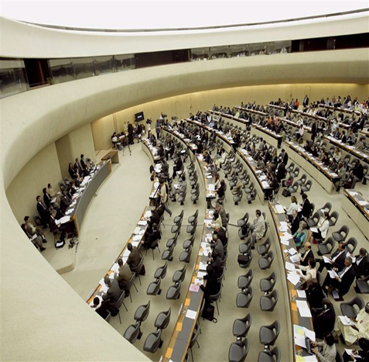
Duty-bearers for the protection of Human Rights
States
  Primary responsibility to protect all persons (rights-holders) under their jurisdiction.
  Each State also has the right & duty to defend & protect
  its nationals abroad.
  WHO WITHIN STATES?
    Legislative
    Executive
    Judicial
    Local authorities/officials
Specialized Agencies (subsidiarity)
  IOM, UNHCR, UNICEF, ILO, OHCHR, ICRC
  Regional orgs.

Slide 14
Human Rights of Migrants
Right to life | Right to liberty
Right to security of person | Right to seek asylum
Right to leave any country | Right to return to own country
Right to freedom of movement | Right to residence
Right to nationality | Right to family life
Right to privacy | Right of access to justice
Right to information | Right to consular access
Right to education | Right to health
Right to housing | Right to work
Right to freedom of thought | Right to religion, culture, language
Notes:
Human rights are the fundamental rights that every person enjoys regardless of his or her nationality, place of residence, sex, national or ethnic origin, colour, religion, language, or any other status. Human rights empower and protect individuals against actions that interfere with fundamental freedoms and human dignity by delimiting State power as well as obliging States to take positive measures to guarantee that these rights can be enjoyed by everyone on their territory.
Human rights are legally guaranteed by international human rights law and the core principles of human rights are:
» Universality and Inalienability: All persons enjoy human rights and they should never be taken away from a person except in specific situations and according to due process. This is reflected by the fact that all States have ratified at least one, and the majority of States have ratified four or more, of the core human rights treaties.
» Interdependency and Indivisibility: Human rights are dependent on others fulfilment in order to be exercised. For example, certain social rights such as health and education may be necessary in order to take advantage of certain civil and political rights and a violation of one right might result in violations of several related rights.
» Equality and Non-discrimination: States must ensure that human rights are applied and respected without any discrimination based on any grounds, including but not restricted to sex, race, colour, language, religion, political or other opinion, national, ethnic or social origin, membership of a national minority, property, birth, age, disability, sexual orientation and social or other status.
Rights
right to life
Right to liberty and security of person (basis for alternatives to detention, and in case of immigration detention, it should be the absolute last resort (lawful, necessary, proportional, legal safeguards) and never for children)
right to seek asylum
right to leave any country, including his own, and to return to his country
right to freedom of movement and residence within the borders of each state (for persons in a regular situation)
right to nationality
right to family life (unity and reunification)
Right to privacy
right of access to justice, including access to information
right to work and to the enjoyment of just and favorable working conditions
right to education (primary, for children, regardless of their migration status, CESCR, CRC)
right to health (information, emergency, but also preventive, curative, and palliative health services all migrants, CESCR. While migrant workers and family equal as nationals).
right to privacy
Right to housing (part of right to health, along with safe and potable water, sanitation, food, nutrition, healthy environment and conditions)
Right to consular access (Article 36 of the Vienna Convention on Consular Relations (VCCR) guarantees non-nationals the right to consular access while held in any form of detention.) Part of the right to access justice includes, Fair proceedings and due process guarantees, which includes right to consular access. The protection and assistance of the consular or diplomatic authorities, based on international law, is also pivotal to ensure migrants’ access to due process guarantees in cases where their rights have not been fully respected by the destination state. Legal safeguards relaed to the right to access justice are extremely crucial for migrants all along the migratory journey and can avoid human rights gaps and remedy violations.

Slide 15
Relevant Norms and Principles
Non-refoulement |  | Non-discrimination
Freedom from torture, inhuman/degrading treatment |  | Freedom from slavery
Prohibition of arbitrary and collective expulsion |  | Prohibition of arbitrary detention
Non-penalization of irregular entry |  | Search, rescue, assistance
Best interests of the child |  | Family unity and reunification
Do no harm |  | Human rights defenders
Gender-responsive migration |  | Human dignity
legal safeguards
HUMAN RIGHTS BASED APPROACH
Respect | Protect |  | Fulfill
law, policies, programs and practices
Notes:
(Mention that the yellow one are jus cogens, not derogatory)
Examples of rights recognized as customary international law:
» Right to life
» Freedom from slavery and involuntary servitude
» Freedom from torture and cruel, inhumane or degrading treatment or punishment > thus, prohibition of it.
» Right to equality before the law and non-discrimination
The key customary norm governing the admission of non-nationals consists in the principle of non-refoulement. The prohibition of removing anyone to a country where there is a real risk of persecution or serious violations of human rights is a common principle endorsed in various branches of IML, namely human rights law, humanitarian law, refugee law and criminal law. It is also endorsed in various universal, regional land bilateral conventions, statement and soft law instruments and jurisprudence. More than 90% of UN Member States are party to one or more treaties explicitly endorsing the principle of non-refoulement.
The principle of non-refoulement must always be respected, and the expulsion of non-nationals in need of international protection, including migrants regardless of their status, asylum seekers, refugees and stateless persons, is prohibited by international law.
Human rights law has expanded the protection realm of migrant populations falling outside the strict definition under Refugee law. Thus, there are persons on the move that could still benefit from different types of protection under the human rights law framework.
Under no circumstances may a person (regardless of their legal status) be expelled to a territory when there are substantial grounds to believe that there is a real risk that they will face torture or cruel, inhuman, or degrading treatment or punishment upon return (ius cogens).
This principle is also important under refugee law and humanitarian law, and human rights law has further increased the protection realm of this principle, also considering social and economic rights violations, as part of that real risk upon return. Examples of risks: torture, and other cruel, inhuman or degrading treatment; flagrant denial of the right to a fair trial; risks of violations to the rights to life, integrity and/or freedom of the person; serious forms of sexual and gender-based violence; death penalty or death row; female genital mutilation; prolonged solitary confinement; severe violations of economic, social and cultural rights (violation of the right to life or freedom from torture, degrading living conditions, lack of medical treatment, or mental illness).
The prohibition of torture is rooted in customary international law which binds all states, and in international treaties which are biding on their State parties. It is a peremptory norm of customary international law and an obligation under all international human rights treaties. THIS IS WHERE NON-REFOULEMENT DERIVES.
The prohibition of arbitrary detention is well established rule of customary international law codified in a broad range of treaties. It includes immigration detention at all phases of the migration cycle. While preserving states’ margin of appreciation, this rule of CIL embodies 3 main limitations regarding the legal basis of detention, its ground and other related procedural guarantees. Also stated in the GCM, which promotes the adoption of alternatives to detention. 1) Any detention must be in accordance with and authorized by law and laws must be accessible and precise in order to avoid all risks of arbitrariness. 2) the deprivation of liberty must be reasonable, necessary, and proportionate. Proportionality further requires states to rely on alternatives to detention that is “less invasive means” to achieve the objectives without interfering with the right to liberty and security. 3 ways of ATD: by entrusting a third party with care and/or responsibility for the migrant and his/her case (community supervision, case management, provision of a guarantor), 2) by requiring a migrant to pay bonds or bail, or 3) by limiting to a lesser or greater extent his/her liberty of movement with reporting requirements, home curfew, electronic monitoring, semi-open centers, designed residence, or house arrest.
The absolute prohibition of collective expulsion stems from the violation of non-discrimination because it requires an individual assessment.
Norms and Principles based on Rights
principle of non-discrimination
non-derogable principle of non-refoulement
prohibition of arbitrary and collective expulsion
prohibition of arbitrary detention
principle of the best interests of the child
Human dignity
gender-responsive migration governance
This is all under a Human rights-based Approach as under international law (to migration governance)
Which entails a State responsibility to Respect, Protect and Fulfill
Which must / should be reflected in State laws, policies, programs and actions, inter alia.
The primary responsibility for ensuring rights standards are met lies with States. International human rights law imposes on States the following obligations: • To respect human rights, that is to refrain from actively violating them; • To protect such rights, that is to intervene and take protective action on behalf of the victim against threats by others or stemming from a situation; • To fulfil them, that is to provide goods and services necessary to allow people to fully enjoy their rights.
States are also responsible for ensuring that these obligations are discharged without discrimination. In a temporal perspective, this means that States have a duty, in particular, to: (a) to prevent violations of human rights from occurring or from re-occurring; (b) to stop them while they are happening, by making sure that State organs and authorities respect the rights concerned and protect victims against threats by third parties or stemming from situations including natural disasters; and (c) ensure reparation and full rehabilitation once a violation has happened.
Examples:
Concerning Family reunification for example, the right to respect for family life typically includes both a positive obligation to protect the family, and a negative obligation prohibiting any unlawful and arbitrary interference with the exercise of the right to family life. Human rights treaty bodies have made it clear that this twofold obligation may require in some circumstances a correlative duty of family reunification.
The prohibition on torture or cruel, inhuman or degrading treatment or punishment:
Duty to respect: The police shall not use torture as a method of questioning of suspects (refrain from interfering with the right).
Duty to protect: Take legislative and other measures prohibiting the acts of torture or cruel, inhuman or degrading treatment or punishment (protect individuals from having his or her rights interfered with by others).
Duty to fulfill: Prosecute those who individuals who violate this prohibition as well as provide training and information to officials on the prohibition of torture as well as cruel, inhuman or degrading treatment and punishment (to take positive action to ensure that the right is respected).
The right to the highest attainable standard of health:
Duty to respect: The State shall not prevent doctors or medical staff from treating those in need of medical assistance (refrain from interfering with this right).
Duty to protect: Protect everyone from non consensual medical treatment, such as medical experiments and research or forced sterilization (protect individuals from having his or her rights interferred with by others).
Duty to fulfill: Provide reproductive, maternal (pre-natal as well as post-natal) and child health care.
Both the Human Rights Committee (CCPR) and the Committee on Economic, Social, and Cultural Rights (CESCR) have clarified that the rights in their respective covenants, with a few exceptions,74 are of general application and, thus, they apply to everyone on the territory of the States parties irrespective of their migration status.75 With a few exceptions, the rights protected under the nine core human rights treaties apply to all people regardless of their race, colour, sex, language, religion, political or other opinion, national or social origin, property, birth or other status, etc. However, in some situations, States may differentiate, derogate and limit certain human rights: » Differential application In exceptional cases, some of the human rights instruments make distinctions between nationals and non-nationals as well as between regular and irregular migrants.
Article 25 of ICCPR only refers to "citizens" and Article 13 ICCPR only applies to "non-nationals lawfully on the territory." In addition, Article 2(3) of ICESCR states: “Developing countries, with due regard to human rights and their national economy, may determine to what extent they would guarantee the economic rights recognized in the present Covenant to non-nationals.” 75 See CCPR General Comments No. 15 and No. 31, CCPR/C/21/Rev.1/Add. 13, para. 10, and CESCR General Comment No. 20, E/C.12/GC/20, para. 30
*Distinctions between nationals and non-nationals as well as between regular and irregular migrants:
The right to vote (Article 25, ICCPR) – expressly applicable only to citizens. The ICRMW makes some distinctions between the rights enjoyed based on the status of the migrant worker and his or her family: Right to join trade unions (Article 26) – applicable to regular and irregular migrant workers and members of their families but Right to form trade unions (Article 40) – applicable to regular migrant workers and members of their families.
» Derogations and limitations on rights: When discussing human rights applicable to migrants, a State’s obligation to uphold a particular right may depend on the circumstances. In exceptional cases, where a public emergency threatens the life of a nation, that State can derogate, or temporarily depart, from some of its obligations under human rights law. An example of this type of derogable right is the right to peaceful assembly. The derogation must be proportional and must not be inconsistent with a State’s other obligations under international law or introduced on a discriminatory basis. However, there are some rights which can never be derogated from, for example:
• The right to life
• Prohibition of torture or cruel, inhuman or degrading treatment or punishment
• Prohibition of slavery
• Recognition before the law
• The right to freedom of thought, conscience and religion
Furthermore, certain human rights can be limited when such limitations are provided for by law and are necessary for the protection of national security or public safety, etc. In contrast to derogation, the right is not taken away but continues to be valid in a limited manner. Examples of these rights are the right to freedom of expression and the freedom of association. The possibility of limiting and the reasons for the limitation are specified in the provision on the right itself.

Slide 16
Rights in relation to the status of the person

Slide 17
Groups of Rights
Economic, social and cultural rights
Civil Rights
Right to life and physical integrity (art. 6 ICCPR)
Right to liberty (art. 9 ICCPR)
Right to freedom of movement (art. 12 ICCPR)
Right to property (salaries, transfer of gains)
Right to respect for private and family life (art. 17 ICCPR)
Access to courts (art. 18 ICRMW)
Right to consular protection and assistance (art. 23)
Right to health (art.12 ICESCR)
Right to an adequate standard of living (art. 12 ICESCR)
Right to education (art. 13 ICESCR)
Right to social security (Arts. 9 et 10 ICESCR)
Labour rights (art. 25 ICRMW)
Respect for cultural identity
(art. 31 ICRMW)
INTERRELATEDNESS

Slide 18

International Covenant on Civil and Political Rights
Applies to all individuals within its territory & subject to its jurisdiction.
EXCEPTIONS:
Political rights apply only to nationals (Art. 25)
Right to return to his or her own country applies only to nationals (& permanent residents) (Art. 12.4)
Right to freedom of movement within the country: only regular migrants (Art. 12.1)
Protection against unlawful deportation: only regular migrants (Art. 13) HOWEVER: this right applies to migrants, including those in an irregular situation + prohibition of collective expulsion applies to everyone.

Slide 19
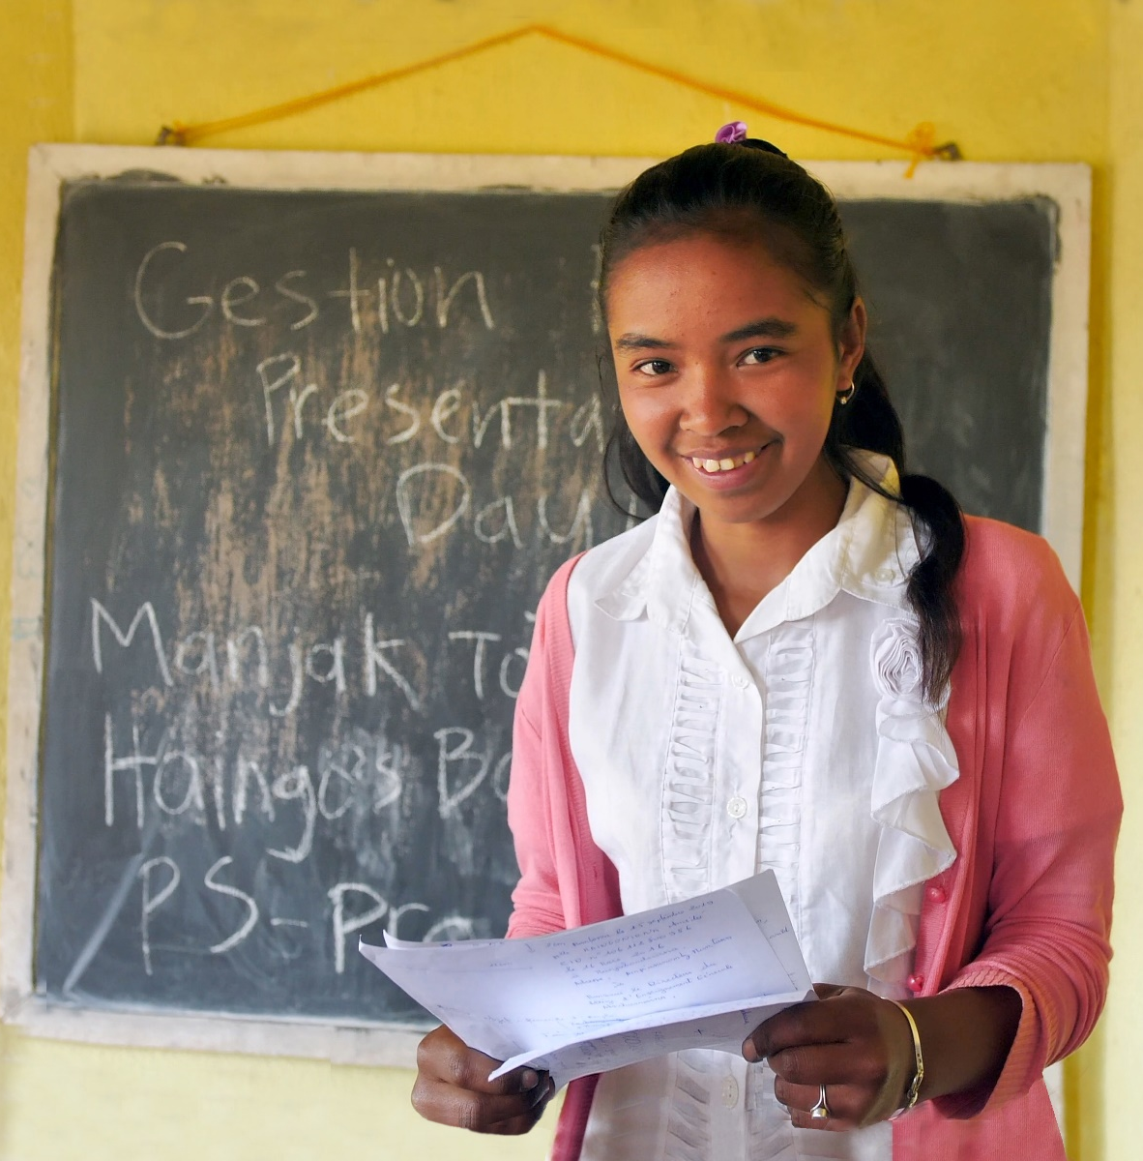
International Covenant on Economic, Social and Cultural Rights
Covenant rights are granted to all individuals without discrimination.
ONLY EXCEPTION:
Art. 2.3. "The developing countries, with due regard to human rights and their national economy, may determine to what extent they would guarantee the economic rights recognized in the present Covenant to non-nationals."
However: the core of core obligations (ie essential food, the right basic health care, the right to shelter, and education).
Progressive realization.

Slide 20
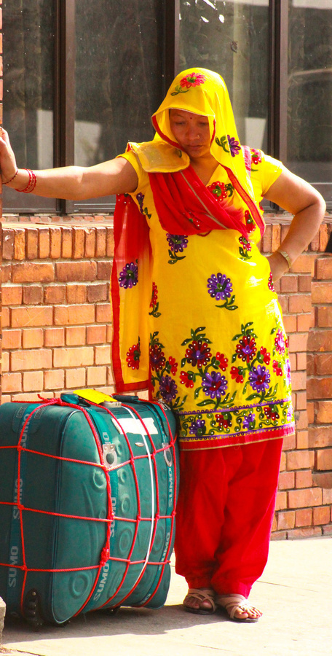
International Convention on the Protection of the Rights of All Migrant Workers and Members of Their Families
Provides rights for both irregular and regular migrant workers and their families.
Examples:
Right to be free from slavery and forced labour
Right to equal treatment at work
Right to join and form a trade union
Right to transfer earnings
Right to be informed

Slide 21
Derogation vs limitation of rights
DEROGATION
Power of the State to defend its security essential feature of state sovereignty.
Limits to derogation:
  Non-discriminatory application
  Limited time
  Notification to the competent bodies
Prescribed by law + proportionate.

Slide 22
Rights that cannot be derogated from
Right to life
Prohibition of genocide
Prohibition of slavery / slave trade
Prohibition of torture
Prohibition against arbitrary detention
Prohibition against racial discrimination
Right to self-determination
Right to equality before the law
Right to leave any country and return to one’s own country
Principle of non-refoulement
Right to freedom of thought and religion
Prohibition against retroactive penal measures
Right to humane treatment as a detainee

Slide 23
Derogation vs limitation of rights
LIMITATION
Some rights are not absolute and may be limited by measures that are necessary to protect:
  security, public order and public health;
  of morality;
  of fundamental rights and freedoms of others.
Prescribed by law + proportionate.
Depends on the treaty.

Slide 24
How to ensure that international standards
are implemented?
At the national level | At the international level
Ratify relevant international standards and integrate them into national legislation Develop a policy | 1. Reports to the HRs committees
3. Implementation of the policy Develop a strategy and define an action plan Create relevant institutions or other administrative structures Build the capacity Allocate the necessary resources Amend relevant laws/adopt new ones | 2. Role of Human Rights Council and of Special Rapporteurs and procedures
4. Courts & tribunals (exhaustion of domestic remedies) | 3. Individual Complaints

Slide 25

Obstacles to the exercise of migrants’ rights
Discriminatory laws, policies & practices
Lack of knowledge (info) of rights & procedures
Language barriers
Cultural differences
Fear of being reported to the authorities (lack of firewalls)
Racial hatred, discrimination & xenophobia
Social exclusion

Slide 26
“Migrants in vulnerable situations”
origin
journey
destination
Ensuring a human rights
based approach
The legal obligation of States to respect, protect and fulfil human rights includes the need to recognize and address vulnerability.
No one is inherently vulnerable!
It is situational
and/or personal.
It can change.
Notes:
The vulnerable situations that migrants face can arise from a range of factors that may intersect or coexist simultaneously, influencing and exacerbating each other and also evolving or changing over time as circumstances change. The concept of vulnerability is a foundational element of the human rights framework. Together with the requirement to uphold human dignity, the need to recognize and address vulnerability underpins the legal obligation of States to respect, protect and fulfil human rights. “Migrants in vulnerable situations” are thus persons who are unable effectively to enjoy their human rights, are at increased risk of violations and abuse and who, accordingly, are entitled to call on a duty bearer’s heightened duty of care. Factors that generate vulnerability may cause a migrant to leave their country of origin in the first place, may occur during transit or at destination, regardless of whether the original movement was freely chosen, or may be related to a migrant’s identity or circumstances. Vulnerability in this context should therefore be understood as both situational and personal.
Vulnerable situations associated with:
the reasons for leaving the country of origin.
situations that migrants encounter during their journey and at destination.
a person’s identity, condition or circumstances.
In either case, however, migrants are not inherently vulnerable, nor do they lack resilience and agency.
Important principle under this concept:
Principle 1
Ensure that human rights are at the centre of efforts to address migration in all its phases, including responses to large and mixed movements.
Principle 2
Counter all forms of discrimination against migrants.
Principle 10
Guarantee the human rights of all children in the context of migration, and ensure that migrant children are treated as children first and foremost.
Principle 11
Protect the human rights of migrant women and girls.
Principle 17
Ensure that all responses to migration, including large or mixed movements, are monitored and accountable.
Principle 18
Respect and support the activities of human rights defenders who promote and protect the human rights of migrants.
Principle 20
Ensure human rights-based and gender-responsive migration governance.
Source: Global Migration Group and OHCHR, 2018, Principles and Guidelines, supported by practical guidance, on the human rights protection of migrants in vulnerable situations
https://www.ohchr.org/Documents/Issues/Migration/PrinciplesAndGuidelines.pdf

Slide 27
Case Study 1
Maria is a migrant young woman who is pregnant and in an irregular situation in Country A, amidst the COVID-19 pandemic. She recently lost her husband to COVID-19. He was also in an irregular situation in Country A.
What are the vulnerabilities of Maria’s situation?
What rights should Maria have access to?
What are the obligations of Country A towards Maria?
What international treaties are relevant in Maria’s case?

Slide 28
Case Study 2
Giorgio is an unaccompanied migrant boy (16 years old) in Country A. He arrived there with a group of migrants by sea last month. His country (B) is in conflict and he lost his family there.
What are the vulnerabilities of Giorgio’s situation?
What rights should Giorgio have access to?
What are the obligations of Country A towards Giorgio?
What international treaties are relevant in Giorgio’s case?

Slide 29
Any questions?
Thank you!

