Slide 1

Human Rights at International Borders
Dr. Gianna Sanchez Moretti
International Migration Law Officer
International Migration Law Unit (IML)
iml@iom.int
IOM, HQ

Slide 2

Learning Objectives
By the end of this session, you will be able to:
Describe the competence of States (sovereignty) regarding migration governance;
Identify the principles that limit States’ authority at borders; and
Name the human rights and principles of migrants at borders.

Slide 3
State Sovereignty, International Law
& Migration Governance
Power to govern migration (including at borders) must be exercised in full respect of States’ international law duties.
International Law
Created by States
State Sovereignty
State Sovereignty
International Borders
State
Sovereignty

Slide 4

Definition - Borders
“… politically defined boundaries separating territory or maritime zones between political entities and to the areas where political entities exercise border governance measures on their territory or extraterritorially (such areas include land checkpoints, border posts at train stations, ports and airports, immigration and transit zones, the high seas and so-called “no-man’s land” between border posts, as well as embassies and consulates).”
- UN Human Rights, Recommended Principles and Guidelines on Human Rights at International Borders, 2014.
Notes:
International borders are not zones of exclusion or exception for human rights obligations. States are entitled to exercise jurisdiction at their international borders, but they must do so in light of their human rights obligations. This means that the human rights of all persons at international borders must be respected in the pursuit of border control, law enforcement and other State objectives, regardless of which authorities perform border governance measures and where such measures take place. Migration discourse is replete with terminology used to categorize people who migrate, such as “unaccompanied or separated children”, “migrants in irregular situations”, “smuggled migrants” or “victims of traffi cking in persons”. In the complex reality of contemporary mobility it can be difficult to neatly separate people into distinct categories as people may simultaneously fi t into several categories, or change from one category to another.

Slide 5

Global Compact for Migration
Objective 11: Manage borders in an integrated,
secure and coordinated manner
”We commit to manage our national borders in a coordinated manner, promoting bilateral and regional cooperation, ensuring security for States, communities and migrants, and facilitating safe and regular cross-border movements of people while preventing irregular migration. We further commit to implement border management policies that respect national sovereignty, the rule of law, obligations under international law, human rights of all migrants, regardless of their migration status, and are
non-discriminatory, gender-responsive and child-sensitive.”

Slide 6
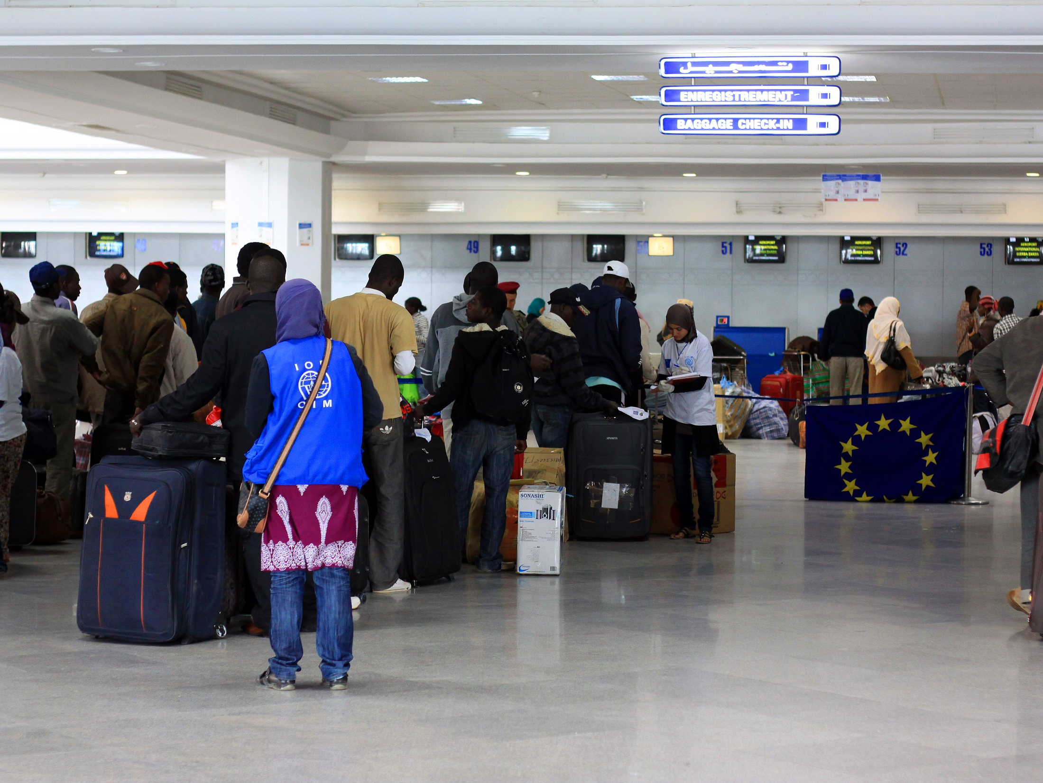
Principles for Departure/Entry

Slide 7

Departure
Competence: The country of origin can require some formalities aimed at keeping track of who is within the country and who has left.
Limitation: The right to leave any country, including one’s own (Art. 13.2 UDHR; Art. 12.2 ICCPR).

Slide 8

Entry/residence
(country of transit/destination)
Competence: The State can decide who is authorized to enter its territory and how, and regulate the person’s residence. However…
Limitations:
Right to seek and enjoy asylum
(Art. 14 UDHR, Art. 12.3 AfCHR, Art. 22.7 AmCHR))
Principle of non-refoulement
Prohibition of collective expulsion (entry)
Right to family reunification (Art. 10 CRC & 44 ICRMW)
Best interests of the child (Art. 3.1 CRC)
Everyone lawfully within the territory of a State shall, within that territory, have the right to liberty of movement & freedom to choose residence (Art. 12.1 ICCPR)
Principles of non-discrimination.
Notes:
Entry: as a general principle of international law, it is at the discretion of the State to grant entry to its territory to non-nationals. However in exercising control of their borders, States must act in conformity with their HR obligations.
Issue of jurisdiction: the person will be considered to have entered the State when he or she accesses its territory. It has also been clearly established that the migrant is within the jurisdiction of the State when he or she is present in an “international zone” or “zone d’attente”. Of an airport ( Amuur v. France ECTHR, 52-53.
However jurisdiction has a wider reach than the national territory of the States. It applies to all persons who falls under the authority or the effective control of the State’s authorities or people acting on its behalf or extra territorial zones , whether of a foreign state or not, where the state exercises effective control ( gen comment 31 CCPR and lopez burgo v. Urugay CCPR Issa and others v. Turkey ECTHR; Coard v. USA IACHR) (e.g., military occupation; where someone is in detention or when s/he is within firing range of the states forces in a border zone. Therefore a State may have obligations to respect and protect the rights of persons who have not entered the territory, but who have otherwise entered areas under the authority and control of the State , or who have been subject to extraterritorial action such as detention.
Of particular relevance for migrants is the fact that states jurisdiction may extend to territorial waters. The IACHR has found that returning asylum seekers intercepted in the high seas to the country of origin violated their right to seek asylum in a foreign country, as protected by the American declaration of the rights and duties of man and the American convention. The ECHR has clearly stated that measures of interception of boats, including on the high seas, attract the jurisdiction of the State implementing the interception. The same principle apply in the context of operations of rescue at sea. (from the moment of effective control of the boat)
That means for example that irregular migrants entering or attempting to enter the territory must not be arbitrarily deprived of their right to life. By agents of the state. - states also have positive obligations to protects migrants from deprivation of life by other actors on entry to the territory, such as smugglers or traffickers. No torture, no excessive physical restraints, cruel treatment etc. (e.g. excessive body searches, compulsory medical testing)
But limited procedural rights for migrants entering a country: right to a fair hearing is unlikely to apply to decisions on entry. It has been expressly excluded by the ECHR Maaouia v. France). The UN human rights committee has left the question open…
NO discrimination upon entry. CCPR gen comment 15. Both the committee and the ECHR found that legislation that limited the right to enter and immunity from deportation to the wives of male citizens and not to the husbands of female citizen violated the prohibition of discrimination on grounds of sex ( mautitanian women case; abdulaziz, Cabales and B v. UK.

Slide 9
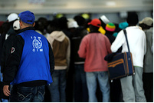

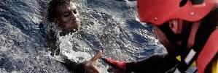
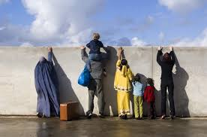
Rights at Borders

Slide 10



Borders are not lawless areas,
including transit areas
Non-discrimination (also for the right to life and rescue - immediate assistance)
Cross-border rights-based governance (right to leave any country including one's own, non-criminalization, humanitarian assistance)
Identification, detection, and orientation/referral
Access to protection systems, in particular asylum
No detention - Alternatives to detention - except when necessary and with limits
Family unity above all
Best interests of the child
Cont ...

Slide 11
Cont…
Principle of non-refoulement
Prohibition of collective expulsions
Protection against excessive use of force
Non-confiscation of personal property
Investigation of rights violation
Access to justice
State jurisdiction and effective control
Border controls and security

Slide 12
Migrants victims of violations
Migration officials who are most likely to encounter victims are in a key position to:
Respond quickly to complaints
Inform victims about the available support structures
(legal, material, medical, psychological, and social)
Investigate, report with care and professionalism
Keep the contact file close at hand, with information
on help structures
Establish cooperation procedures with aid structures
(medical, social, legal)
Cont ...

Slide 13
Cont…
Ensure that a female agent is present during all
contact with female victims
Explain to victims what their rights, roles and
the nature of the proceedings are
Provide transportation to a safe location
Secure files and protect the privacy of victims
Establish guidelines on victim assistance
Access to justice

Slide 14

Principle of non-refoulement jus cogens
Art. 33.1, 1951 Refugee Convention: Prohibition of expulsion or return
“No Contracting State shall expel or return ("refouler") a refugee in any manner whatsoever to the frontiers of territories where his life or freedom would be threatened on account of his race, religion, nationality, membership of a particular social group or political opinion”
Art. 3, Convention against Torture: “No State Party shall expel, return ("refouler") or extradite a person to another State where there are substantial grounds for believing that he would be in danger of being subjected to torture.”
+ HUMAN RIGHTS:
- prohibition of torture, inhumane and degrading treatment.
the right to life and physical integrity.
  person directly targeted, group exposed to ill-treatment practices, indiscriminate violence, degrading living and detention conditions, health conditions, forced labor or slavery, conditions surrounding a death penalty.
Non-refoulement principle also applies to migrants, because they have human rights (so there are rights protection concerns to look into first).
Notes:
Article 33 - Prohibition of expulsion or return ("refoulement")
1. No Contracting State shall expel or return (" refouler ") a refugee in any manner whatsoever to the frontiers of territories where his life or freedom would be threatened on account of his race, religion, nationality, membership of a particular social group or political opinion.
2. The benefit of the present provision may not, however, be claimed by a refugee whom there are reasonable grounds for regarding as a danger to the security of the country in which he is, or who, having been convicted by a final judgement of a particularly serious crime, constitutes a danger to the community of that country.
Article 3 CAT
1. No State Party shall expel, return ("refouler") or extradite a person to another State where there are substantial grounds for believing that he would be in danger of being subjected to torture.
2. For the purpose of determining whether there are such grounds, the competent authorities shall take into account all relevant considerations including, where applicable, the existence in the State concerned of a consistent pattern of gross, flagrant or mass violations of human rights.Art. 7 PIDCP
Art. 5 Charte africaine

Slide 15
Children & Non-refoulement
“State obligations under the Convention apply within the borders of a State, including with respect to those children who come under the State’s jurisdiction while attempting to enter the country’s territory. Therefore, the enjoyment of rights stipulated in the Convention is not limited to children who are citizens of a State party and must therefore, if not explicitly stated otherwise in the Convention, also be available to all children – including asylum-seeking, refugee and migrant children – irrespective of their nationality, immigration status or statelessness”.
(CRC General Comment No. 6: “Treatment of unaccompanied and separated children outside their country of origin”)
Above all, a child is a child (below 18 years) regardless of migration status > entitled to same rights and treatment as national children.

Slide 16
Global Compact for Migration
Objective 21: Cooperate in facilitating safe and dignified return and readmission, as well as sustainable reintegration
Para. 37 “We commit to facilitate and cooperate for safe and dignified return and to guarantee due process, individual assessment and effective remedy, by upholding the prohibition of collective expulsion and of returning migrants when there is a real and foreseeable risk of death, torture, and other cruel, inhuman, and degrading treatment or punishment, or other irreparable harm, in accordance with our obligations under international human rights law.”

Slide 17
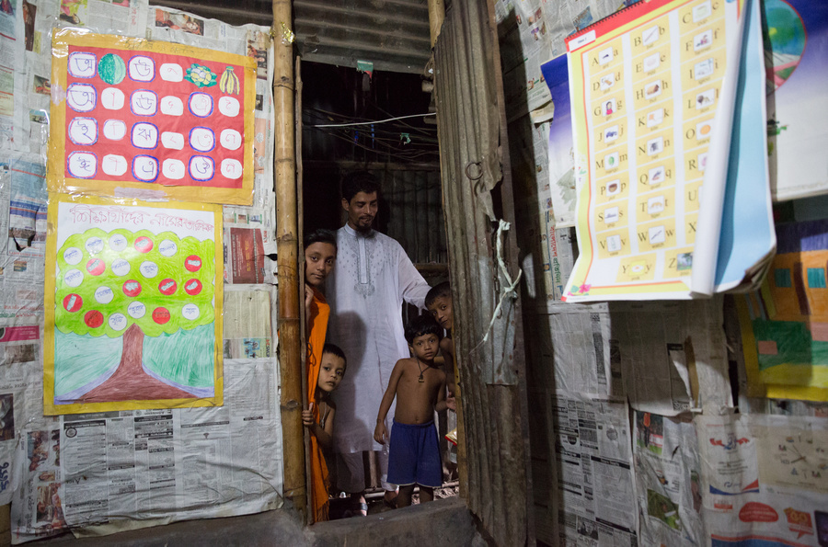
Family Reunification
Set out for regular migrant workers in Art. 44 ICRMW:
“the family is the natural and fundamental group unit of society and is entitled to protection by society and the State, shall take appropriate measures to ensure the protection of the unity of the families of migrant workers...take measures that they deem appropriate and that fall within their competence to facilitate the reunification of migrant workers with their spouses or persons who have with the migrant worker a relationship…”
Possibility to relocate abroad (case by case)
Particular attention to children, Art. 10 CRC
Principle of non-discrimination if the right is granted to certain categories of migrants
Requirements not too restrictive (period of residence, language test, suitable housing)
Notes:
Article 44 ICRMW:
1. States Parties, recognizing that the family is the natural and fundamental group unit of society and is entitled to protection by society and the State, shall take appropriate measures to ensure the protection of the unity of the families of migrant workers.
2. States Parties shall take measures that they deem appropriate and that fall within their competence to facilitate the reunification of migrant workers with their spouses or persons who have with the migrant worker a relationship that, according to applicable law, produces effects equivalent to marriage, as well as with their minor dependent unmarried children.
3. States of employment, on humanitarian grounds, shall favourably consider granting equal treatment, as set forth in paragraph 2 of the present article, to other family members of migrant workers.
Fam reunification: when a migrant reaches a relatively stable condition of residence in a foreign state, may wish to bring family members to that state. , migration of family members raises issues of the right to respect for family life.
Express obligations of int. legal protection for family reunification in the destination country are relatively scant. The Refugee convention does not specifically recognize a right of refufugees to family reunification, although the final act of the conference proclaimed that “the unity if the family , the natural and fundamental group unit of society , is an essential right of the refugee.” ICRMW says that “state parties shall take measure sthat the deem appropriate and that fall within their competence to facilitate the reunification of migrant workers (in a regular situation) with their spouses …. As well as minor dependent unmarried children”. EU charter “faciluate as far as possible the reunion of the family (…of a worker allowed to establish himself/herself”).
See ECHR: obligation arise only in limited circumstances, in light of the principle of States control of entry to its territory, and the court has emphasized that article 8 does not require States to respect respect choice of matrim0nial residence or authorize family reunification in their territory. (Gul v. Switzerland). Under article 8 there will be however a positive obligation on the state of destination to facilitate family reunification on its territory where there is an insurmountable objective obstacle preventing the migrant already with its jurisdiction from realizing his or her family life rights in any other place (se Benamar and others v. Netherlands). The Court will take into consideration the reasons why one family member left his or her State of origin or residence without other members of the family. Fleeing war and/or seeking asylum might be strong arguments that hinder the development of family life outside of the country of destination. As between two adults, it will be difficult to plead the existence of an unsurmountable obstacle against living together in the country of origin, unless the person in the country of destination is there as a refugee or beneficiary of international protection. (see turquabo-tekle and others v. Netherlands”.
Obstacles to or conditions for family reunification will violate the right to respect for family life where they can be shown to be unreasonable. The Court did not consider unreasonable a requirement of demonstrating sufficient independent and lasting income, not being welfare benefits, to provide for the basic costs of subsistence of the family members with whom reunification is sought. (Haydarie and Others v. Netherlands)
Also there must be no breach of principle of non discrimination (either by favoring or to the detriment of one gender to reunify family).
Family= evolving according to social attitudes (two broad categories: children and partnerships) For adult parents and adult children, an additional element of dependence is normally required to give rise to the protection of the right to a family life.
HR Commitee said family as understood in the society concerned. The right to family life is not necessarily obviated by geographical separation, infidelity, or the absence of conjugal relations. However there must be first a family bond to protect.
Obstacles to or conditions.
MS are not obliged to respect the choice of married couples to reside in a certain country
Art 9, 10 (CRC)
Applications by a child or their parents to enter or leave the country for family reunification shall be dealt in a positive, humane and expeditious manner
3. Sen v. Netherlands daughter left behind in Turkey when the parents moved to the Netherlands – violation of art. 8 due to refusal of the authorities to allow her to join her parents (when she was 9 year old).
Beneficiaries of permits to stay in the Netherlands, the two first applicants had established their life as a couple in the Netherlands, where they had lived legally since many years and where two more children were born. Those two children lived their whole lives in the Netherlands, in the cultural and educational environment of this country. Therefore, they have little or no connection with their country of origin. Under these conditions, the most appropriate way to develop family life was, given the young age of the third applicant, by bringing her to the Netherlands.
4. A requirement of suitable housing should not be too restrictive as to prevent family reunion
A period of more than one year of residence for the person to be joined by the family is excessively long
Requirement of evidence of integration to get the leave to remain (language test) is not proportionate

Slide 18
Members of the Family
Art. 4, ICRMW:
persons married to migrant workers or having with them a relationship that, according to applicable law, produces effects equivalent to marriage;
dependent children; and
other dependent persons who are recognized as members of the family by applicable legislation or applicable bilateral or multilateral agreements between the States concerned.

Slide 19
Global Compact for Migration
Objective 5: Enhance availability and flexibility of pathways for regular migration
Para. 21 g) Develop or build on existing national and regional practices for admission and stay of appropriate duration based on compassionate, humanitarian or other considerations for migrants compelled to leave their countries of origin, due to sudden-onset natural disasters and other precarious situations, such as by providing humanitarian visas, private sponsorships, access to education for children, and temporary work permits, while adaptation in or return to their country of origin is not possible.

Slide 20

Exit and Return

Slide 21

Collective expulsions
Any measure of the competent authority compelling migrants as a group to leave the country, “except where such a measure is taken after and on the basis of a reasonable and objective examination of the particular cases of each individual alien of the group” (ECtHR, Čonka v. Belgium, 2002)
Migrants’ human dignity & human rights
Procedural guarantees
Identify needs of special protection or
other reasons not to be returned (family reunification/unity)
Art. 22 ICRMW and Art. 22.9 AmCHR +
Mass expulsion of national, racial, ethnic
or religious groups (Art. 12.5 AfCHPR)

Slide 22
Collective expulsions: “Group”
Case N.D. and N.T. v. Spain (ECtHR, 2020)
“The group does not have to comprise a minimum number of individuals below which the collective nature of the expulsion would be called into question...the number of persons affected by a given measure is irrelevant in determining whether or not there has been a violation of Article 4 of Protocol No. 4 [prohibition of collective expulsions]….the Court has never hitherto required that the collective nature of an expulsion should be determined by membership of a particular group or one defined by specific characteristics such as origin, nationality, beliefs or any other factor, in order for Article 4 of Protocol No. 4 to come into play. The decisive criterion in order for an expulsion to be characterised as “collective” is the absence of “a reasonable and objective examination of the particular case of each individual alien of the group”

Slide 23
Limitations on Expulsions
Competence: The State has the competence to decide who must leave the country.
Limitations:
Principle of non-refoulement
Prohibition of collective/mass expulsion (Art 22.1 ICRMW, Art. 12.5. ACHPR, ACmHPR)
Right to respect for private and family life (Art. 17 ICCPR, Art. 9.1 CRC)
Best interests of the child (Art. 3 CRC) – wellbeing
A State cannot expel its own nationals/its own country (Art.12.4 ICCPR)
Procedural guarantees…
Notes:
Implies that you cannot expel your own nationals, can maybe expel in case of dual nationality and the other state agrees to take the individual. National law often prohibits the expulsion.
Right to return: HRC General Comment 27:
Right to remain in one's own country.
Right to return after having left one's own country.
Right to come to ones country for the first time if born abroad.
3. Individual assessment is key.
Group of Gambians working in the mining industry (with resident permits) was expelled from Angola en masse on May 23, 2004. “simply because the victims were a part of a larger group of non-nationals, not just Gambians, but also other West and Central Africans, does not negate discrimination on the part of the Respondent State,” and that the fact that “so many aliens received the same treatment is tantamount to an admission of a violation of Article 12(5).” Moreover, the fact that the deportees as a group were arrested over a period of several months at different places and may have been served with deportation orders on different dates does not qualify, for purposes of the African Commission, to be sufficient to negate the en masse[[/i]] element of the expulsions.²⁴ The African Commission underscores that any expulsions or deportations must comply with the human rights obligations found in the African Charter. Accordingly, the African Commission finds the Respondent State in violation of Article 12(5) of the African Charter.
Maslov v. Austria
Maslov was a minor when he committed a number of non-serious crimes. He was 19 when Autria expelled him from Bulgaria.
4. Family rights: Factors to be examined include the length of residence; the age of the children and the impact of expulsion of a parent; the conduct of the parent; proportionality to the aim pursued- the state’s interests in protecting public safety and promoting compliance with immigration laws. As in the admissions context, however, it has been recognized that expulsion does not necessarily destroy family unity; it may simply cause relocation of the entire family to another state.”1
!! However, it should be noted that in sharp contrast to the ICCPR, which prohibits only ‘arbitrary and unlawful’ interference with the family, the CRC does not recognize a public interest to be weighed against the involuntary separation of the family. The only exception allowed is when separation is necessary for the best interests of the child.
States Parties shall ensure that a child shall not be separated from his or her parents against their will, except when competent authorities subject to judicial review determine, in accordance with applicable law and procedures, that such separation is necessary for the best interests of the child.
ECHR
In a large number of judgments the Court has found a violation of Article 8 in cases
involving the expulsion of aliens: Boultif v. Switzerland 02/08/2001; Benhebba v. France
10/07/2003; Maslov v. Austria 23/06/2008 (Grand Chamber); Kaushal and Others v.
Bulgaria of 02/09/2010, Gelerie v. Romania 15/02/2011; etc.
In the case of K.A.B. v. Spain (10.04.2012), the Court found a violation of Article 8
concerning the adoption – despite the father’s opposition – of a child who was declared
abandoned after his mother’s deportation.
The Court found, in particular, that the authorities’ inaction, the deportation of the
mother without prior verification, the failure to assist the applicant with his formalities, in
spite of his precarious situation, and the exclusive attribution of responsibility to the
applicant for the child’s abandonment, had decisively contributed to preventing any
possibility of reunion between father and son, in breach of the applicant’s right to
respect for his private life.
Balogun v. United Kingdom 10/04/2012: no violation of Article 8. A Nigerian national
complained that his deportation would breach his right not to be ill-treated as well as his
right to private life. The Court found that, although the applicant was a settled migrant,
the seriousness of the multiple drugs-related offences he had committed as an adult,
coupled with the carefully considered preventive steps of the UK authorities to mitigate
any risk of suicide, were sufficient to justify his deportation.
Boultif v. Switzerland
In 1996, Mr. Boultif, a resident alien of Switzerland, was convicted of a violent robbery for which he received a two-year unconditional prison sentence.n1 After Mr. Boultif served his time, the Swiss government ordered his expulsion. n2 Nevertheless, Mr. Boultif assertively resisted deportation to avoid separation from his wife, a Swiss citizen. n3
His domestic remedies exhausted,n4 Mr. Boultif took his case to the European Court of Human Rights (Court) claiming that by ordering his expulsion, the Swiss government violated his right to privacy and respect for family life guaranteed under Article 8 of the European Convention for the Protection of Human Rights and Fundamental Freedoms (Convention). n5 Specifically, he alleged that the violation occurred when the Swiss government refused to renew his residence permit, thus separating him from his wife, a swiss national. n6 Luckily for Mr. Boultif, the Court ruled in his favor, found an Article 8 violation,n7 and ordered the Swiss government to pay Mr. Boultif's costs and expenses. N8
Uner v. Netherlands criteria for expulsion in case of commission of an offence:
- the nature and seriousness of the offence committed by the applicant;
- the length of the applicant’s stay in the country from which he or she is to be expelled;
- the time elapsed since the offence was committed and the applicant’s conduct during that period;
- the nationalities of the various persons concerned;
- the applicant’s family situation, such as the length of the marriage, and other factors expressing the effectiveness of a couple’s family life;
- whether the spouse knew about the offence at the time when he or she entered into a family relationship;
- whether there are children of the marriage, and if so, their age; and
- the seriousness of the difficulties which the spouse is likely to encounter in the country to which the applicant is to be expelled.
- the solidity of social, cultural and family ties with the host country and with the country of destination.”
4. D. v. United Kingdom 02/05/1997: violation of Article 3 if an order for the
deportation to Saint-Kitts of an Aids sufferer in the last stages of the disease
were to be enforced.
N. v. the United Kingdom (no. 26565/05), 27/05/2008 (Grand Chamber): The
applicant, a Ugandan national, was admitted to hospital days after she arrived in
the UK as she was seriously ill and suffering from AIDS-related illnesses. Her
application for asylum was unsuccessful. She claimed that she would be subjected
to inhuman or degrading treatment if made to return to Uganda because she
would not be able to get the necessary medical treatment there.
The Court noted that the UK authorities had provided the applicant with medical
treatment during the nine years it had taken for her asylum application and
claims to be determined by the UK courts and the European Court of Human
Rights. The Convention did not place an obligation on States parties to account
for disparities in medical treatment in States not parties to the Convention by
providing free and unlimited medical treatment to all aliens without a right to stay
within their jurisdiction. Therefore, the UK did not have the duty to continue to
provide for the applicant. Non-violation
5. National law may establish a special court to decide on the expulsion of minors
ECtHR Anayo v. Germany (21 december 2011) and Saleck Bardi v. Germany (24 May 2011) – failure to consider best interest fo the child in removal procedures + lack of coordination between authorities in determining such interest.
“the best interests and well-being of the children, in particular the seriousness of the difficulties which any children of the applicant are likely to encounter in the country to which the applicant is to be expelled” Boultif v. Switzerland
CCPR, Al-Gertani (Iraqi) v. Bosnia Herzegovina, 1 November 2013
Communication No. 1955/2010
10.7 The Committee takes note of the author’s claims under articles 17, 23 and 24 of the Covenant that his detention and possible deportation constitute an arbitrary and unlawful interference with his privacy and family life since it would entail splitting up his family, with a negative impact on the well-being of his children. His wife and minor children are nationals of Bosnia and Herzegovina, do not speak Arabic, and have no ties whatsoever to the Iraqi culture. Furthermore, they cannot follow him to a country facing a civil war with a deplorable security situation. The Committee also takes note of the State party’s argument that the right to privacy and family life are not absolute rights and that they may be restricted for reasons of public interest.
10.8 The Committee recalls its jurisprudence according to which the separation of a person from his family by means of his expulsion constitutes an interference with the family life protected by article 17, paragraph 1, of the Covenant. In cases where one part of a family must leave the territory of the State party while the other part would be entitled to remain, the relevant criteria for assessing whether or not the specific interference with family life amounts to arbitrary interference or can be objectively justified must be considered in the light of, on the one hand, the significance of the State party’s reasons for the removal of the person concerned and, on the other, the degree of hardship the family and its members would encounter as a consequence of such removal.
10.9 In the present case, the Committee observes that the removal of the author would impose considerable hardship on his family. If the author’s wife and minor children were to decide to immigrate to Iraq in order to avoid a separation of the family, they would have to live in a country whose culture and language are unfamiliar. The Committee also observes that when deciding the removal of the author, the Court of Bosnia and Herzegovina and the Constitutional Court limited themselves to referring to the fact that the author was considered a threat to national security without properly assessing this reason for removal. Further, these courts failed to give the author an adequate opportunity to address the alleged security threat in a manner that would enable him to contribute to an appropriate assessment of the effects of his removal on his family situation. In the absence of a clear explanation from the State party as to why the author constitutes a threat to the security of the country or why this information cannot be transmitted, the Committee is of the view that the State party has failed to show that the interference with his family life is justified by serious and objective reasons. Accordingly, the Committee considers that under the circumstances the author’s deportation would constitute a violation of articles 17 and 23 of the Covenant.
See communication No. 558/1993, Canepa v. Canada, Views adopted on 3 April 1997, para. 11.4.
See communication No. 1011/2001, Madafferi v. Australia, Views adopted on 26 July 2004, para. 9.8.

Slide 24
Expulsions: Procedural Guarantees
  Procedural guarantees (Art. 22 ICRMW – Art. 13 ICCPR only for migrants in a regular situation):
  Principle of Legality (in pursuance of a decision taken by the competent authority in accordance with law)
  Right to submit reasons against the expulsion +
  If found by a court unlawful: Right to seek compensation and right to re-enter.
  Time to settle wages
  Cost of expulsion (excluding the travel) shall not be borne by the migrant
Notes:
4.
Gebremedhin v. France 26/04/2007: the applicant complained that under French law
there was no remedy with suspensive effect against decisions refusing leave to enter the
country or directing removal. Violation of Article 13 taken in conjunction with
Article 3.

Slide 25
Expulsions: Conditions
No specific instrument – general provisions apply (prohibition on degrading and inhumane treatment)
Time to prepare
Humane treatment during – excessive force by escorts / accountability
Property rights and similar interests
Health considerations
Monitoring
Notes:
(CPT)
forcible departure with an escort, and on a number of cases brought to its attention, in particular because of the death of the deported person, the extent of the means of restraint used and/or allegations of ill-treatment.
.In most cases, the detainee will be in full possession of his/her physical faculties and able to resist handcuffing violently. In cases where resistance is encountered, escort staff usually immobilise the detainee completely on the ground, face down, in order to put on the handcuffs. Keeping a detainee in such a position, in particular with escort staff putting their weight on various parts of the body (pressure on the ribcage, knees on the back, immobilisation of the neck) when the person concerned puts up a struggle, entails a risk of positional asphyxia. See, in particular, “Positional Asphyxia – Sudden Death”, US Department of Justice, June 1995, and the proceedings of the “Safer Restraint” Conference held in London in April 2002 under the aegis of the UK Police Complaints Authority (cf. www.pca.gov.uk).
, having been placed on a seat in the aircraft, struggles and the escort staff, by applying force, oblige him/her to bend forward, head between the knees, thus strongly compressing the ribcage.

Slide 26

Right to return > obligation to re-admit
Art. 12.4 ICCPR: “No one shall be arbitrarily deprived of the right to enter his own country.”
Obligation toward individuals
And towards States
GCM, Objective 21: Cooperate in facilitating safe and dignified return and readmission, as well as sustainable reintegration
Para. 37 … “ensure that our nationals are duly received and readmitted, in full respect for the human right to return to one’s own country and the obligation of States to readmit their own nationals … create conducive conditions for personal safety, economic empowerment, inclusion and social cohesion in communities, in order to ensure that reintegration of migrants upon return to their countries of origin is sustainable.”
c) on cooperating in the identification of own nationals

Slide 27

Trafficking and Smuggling of Migrants

Slide 28
Trafficking in Persons definition
“The recruitment, transportation, transfer, harboring or receipt of persons, by means of threat, use of force or other means of coercion, of abduction, of fraud, of deception, of the abuse of power or of a position of vulnerability or of the receiving or giving of payment… to a person having control over another person, for the purpose of exploitation”
(Article 3, Protocol to Prevent, Suppress and Punish Trafficking in Persons)
Notes:
The first ever definition of trafficking as trafficking
-The complexity of the definition, or perhaps rather the complex representations of the definition, have brought problems when it has been adopted word for word in national legislation and passed to law enforcement officials as an operational definition of a crime they are supposed to detect or prevent. They consequently resort to various shortcuts to enforce the law and, in doing so, often misapply or misinterpret the definition

Slide 29
Elements of Trafficking
Act
Recruitment
Means
Threat
Purpose
Exploitation including:
Transport
Transfer
Harbouring
Receipt of persons
Use of force
Abuse of power or of a position of vulnerability
Other means of coercion
Abduction
Fraud
Deception,
Receiving or giving of payment
Prostitution of others
Sexual exploitation
Forced labour
Slavery or similar practices
Removal of organs
Others

Slide 30
Trafficking
(Palermo Protocol)
Penalizes trafficking (crime)
Proactive investigations
Proceedings & sanctions against traffickers
International cooperation
Protection of migrants (victims)
Access to justice
Non criminalization of migrants (victims)
Irregular migration as such should not be criminalized because it is excessive. (UN Working Group on Arbitrary Detention)

Slide 31

Trafficking in Persons
Fact:
Though some victims of trafficking are brought into countries illegally, others travel using legal documents or enter on valid work visas
Notes:
Note: Remind the participants that traffickers look at existing movements and migratory flows - including legal ones - to exploit. This means that valid student, work, and tourist visas can all be part of the movement associated with trafficking.
Remind participants that transporting victims of trafficking legally can reduce the risk to traffickers.

Slide 32
Smuggling definition
“Smuggling of migrants” shall mean the procurement, in order to obtain, directly or indirectly, a financial or other material benefit, of the illegal entry of a person into a State Party of which the person is not a national or a permanent resident;
“Illegal entry” shall mean crossing borders without complying with the necessary requirements for legal entry into the receiving State;
(Article 3, Protocol against the Smuggling of Migrants by Land, Sea and Air)
Notes:
A major achievement of the Protocol was that, for the first time in a global international instrument, a definition of smuggling of migrants was developed and agreed upon.

Slide 33
Elements of Smuggling
Act
Transportation and transfer of persons illegally into a State (crossing international borders)
Means
No element of distortion of the free will of the person, either by force, deception or abuse of power. In most smuggling cases, the intending irregular migrants seek and initiate the contact with smugglers themselves to realize their objective of crossing the border into a country illegally
Purpose
Financial profit from the illegal border crossing
Notes:
Free will is contraversial as it depends on the situation
Note: Reinforce that the purpose is completely different in smuggling of migrants
– the financial gain is through the illegal border crossing
Because of financial or material profit it excludes those who are trying to save someone from persecution out of good will

Slide 34
Requires States to:
Criminalize smuggling;
Co-operate to prevent smuggling;
Strengthen border controls to detect smuggling;
Address root causes;
Appropriate measures to “preserve and protect” rights;
Cooperate in return.
Notes:
1: plus Aggravating factors
Endanger to lives and safety;
Inhuman, degrading treatment and exploitation.
6: Cooperation to prevent and suppress the smuggling of migrants by sea;
Exchange of information;
Border management and cooperation among border control agencies;
Verify travel documents;
Personnel training (Cooperation with organizations, NGOs etc)
Return

Slide 35
Important
Article 5 on non-criminalization:
“Migrants shall not become liable to criminal prosecution under this Protocol for the fact of having been the object of conduct set forth in article 6 of this Protocol.”
Notes:
Not to smuggling but can be guilty to an administrative offence

Slide 36

Migration by Sea
Some key principles

Slide 37

Law of the Sea (relevant for migration)
1982: UN Convention on the Law of the Sea (UNCLOS) 167 + EU
1974: International Convention for the Safety of Life at Sea (SOLAS) 164
1979: International Convention on Maritime Search and Rescue (SAR) 67
+ IMO Guidelines, Circulars, Resolutions and Amendments
Shipmaster responsibility | Flag State jurisdiction, duties
Assistance & treatment (medical, needs) | Rescue of persons in distress/lost at sea
Sea search & rescue operations | Cooperation & Coordination (SAR)
Place of safety | Safe & prompt disembarkation
Saving lives
Non-discrimination (legal status)
Balancing rights, duties & security

Slide 38

RECAP
Principles at international borders
Primacy of human rights
Non-discrimination
Assistance and protection from harm

Slide 39

Recap: International Borders
The right to leave any country, including one’s own (Art.12 ICCPR)
Right to seek and enjoy asylum (Art.14 UDHR)
Principle of non-refoulement
Prohibition of collective expulsion (entry)
Right to family unity/reunification (Art.19 CRC, Art.44 ICRMW)
Right to respect for private life (Art.17 ICCPR)
Best interests of the child (Art.3 CRC)
A State cannot expel its own nationals/its own country + everyone has the right to return to one’s own country (Art.12 ICCPR)
Procedural and substantive conditions surrounding expulsion

Slide 40

Principles at international borders
Promotion and protection of human rights
Legal and policy framework
Building human rights capacity
Ensuring human rights in rescue and interception
Human rights in the context of immediate assistance
Screening and interviewing
Identification and referral
Avoiding detention
Human rights-based return or removal
Cooperation and coordination

Slide 41
Question
What are two of the main differences between
smuggling and trafficking? (2 are correct)
a. Trafficking is run by organized crime groups, smuggling is generally not organized.
b. Trafficking is conducted on land, while smuggling usually occurs via sea.
c. Smuggling only happens across an international border, trafficking can happen within a state/territory (domestically) or across a border (internationally).
d. Trafficking is a crime against the individual, smuggling is a crime against the State.

Slide 42
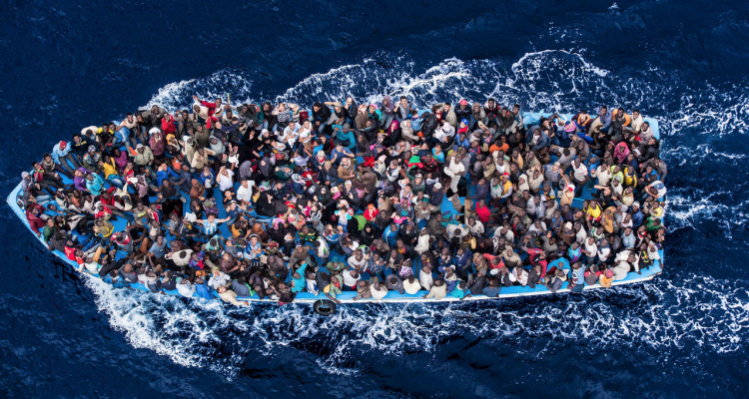
Does the principle of non-refoulement
apply in the high seas?
Migrants from different countries try to make a boat trip to country B. Their boat is overloaded, and it capsizes in international waters.
All the migrants were rescued by a boat flying the flag of Country B. The migrants in fear ask the crew of the boat not to be brought back to the country of departure A, which is nearby.
Can the captain of the boat bring them back to Country A?
What Law of the Sea principles apply in this case?

Slide 43
Case
Violeta is at the border of country B. In her country of origin A, a few months ago, a conflict broke out. Violeta lived in the capital where the level of violence is so high that residents are advised not to leave their homes. Attacks from various forces are frequent and often directed against civilians as some armed factions believe soldiers and rebels are hiding there.
Can the authorities in country B refuse Violeta's entry
into their country?

Slide 44
Case
Luisa is a migrant in an irregular situation who returned irregularly to Country B. When arrested by the authorities, she said that she fled her country of origin A because she feared violence from her family after having an extramarital affair. The authorities of country B are informed that the level of violence against women is very high in country A and that women are treated as second-class citizens, especially if they are single.
Can border authorities send Luisa back to her country of origin?

Slide 45
Case
Ana is a national of country B who had been living in country C for a few years, but as she had worked without a permit, she was deported from C. She is now back in B and wants to migrate abroad to find work. However, according to the legislation in force in her country, due to her deportation, she was banned from traveling for two years. Ana, however, really wants to her country again.
Can authorities from Country B prevent her from leaving the country?

Slide 46
Case
Since the global economic crisis, the youth unemployment rate in the country of Paulo (A) has reached a terrible level of 70%.
Paulo, who is 20 years old, has been unemployed for 2 years and finds himself in a dire situation because he has no way of supporting his wife and 3 children. He wants to immigrate to B
to find a decent, well-paid job.
Do the authorities have an obligation to let him enter country B?

Slide 47
Thanks for your participation!
Any questions?

