Slide 1



2-day regional course on “INTERNATIONAL MIGRATION LAW”, 17-18 February 2022
REGIONAL TRAINING CENTER ON MIGRATION

Slide 2

THE UN NETWORK ON MIGRATION
Established by the Secretary-General in 2018 to ensure effective, coordinated systemwide support to the implementation, follow up and review of the GCM.
Consists of 39 entities of the UN system who wish to be a part of it and for whom migration is of relevance to their mandate.
An Executive Committee (9 entities – currently UNDESA, ILO, IOM, OHCHR, UNDP, UNHCR, UNICEF, UNODC, WHO)
IOM serves as the Coordinator and Secretariat
A Network workplan for GCM implementation

Slide 3
NETWORK MEMBERSHIP
United Nations Economic Commission for Latin America and the Caribbean (UNECLAC)
United Nations Economic and Social Commission for Asia and the Pacific (UNESCAP)
United Nations Economic and Social Commission for Western Asia (UNESCWA)
United Nations Economic Commission for Europe (UNECE)
United Nations Entity for Gender Equality and the Empowerment of Women (UN Women)
United Nations Environment (UNE)
United Nations Framework Convention on Climate Change secretariat (UNFCCC)
United Nations High Commissioner for Refugees (UNHCR)
United Nations Human Settlements Programme (UN Habitat)
United Nations Industrial Development Organization (UNIDO)
United Nations Institute for Training and Research (UNITAR)
United Nations Office on Drugs and Crime (UNODC)
United Nations Population Fund (UNFPA)
United Nations Sustainable Development Group (UNSDG) secretariat
United Nations University (UNU)
Universal Postal Union (UPU)
World Food Programme (WFP)
World Bank
World Health Organization (WHO)
Chief Executives Board secretariat (CEB)
Department of Economic and Social Affairs (DESA)
Department of Public Information (DPI)
Food and Agriculture Organization (FAO)
Inter-Agency Standing Committee secretariat (IASC)
International Fund for Agricultural Development (IFAD)
International Labour Organization (ILO)
International Maritime Organization (IMO)
International Organization for Migration (IOM)
Joint United Nations Programme on HIV/AIDS (UNAIDS)
Multi-Partner Trust Fund Office (MPTFO)
Office for the Coordination of Humanitarian Affairs (OCHA)
Office of the High Commissioner for Human Rights (OHCHR)
Peacebuilding Support Office (PBSO)
United Nations Alliance of Civilizations (UNAoC)
United Nations Children’s Fund (UNICEF)
United Nations Conference for Trade and Development (UNCTAD)
United Nations Development Programme (UNDP)
United Nations Economic, Social and Cultural Organization (UNESCO) United Nations Economic Commission for Africa (UNECA)

Slide 4
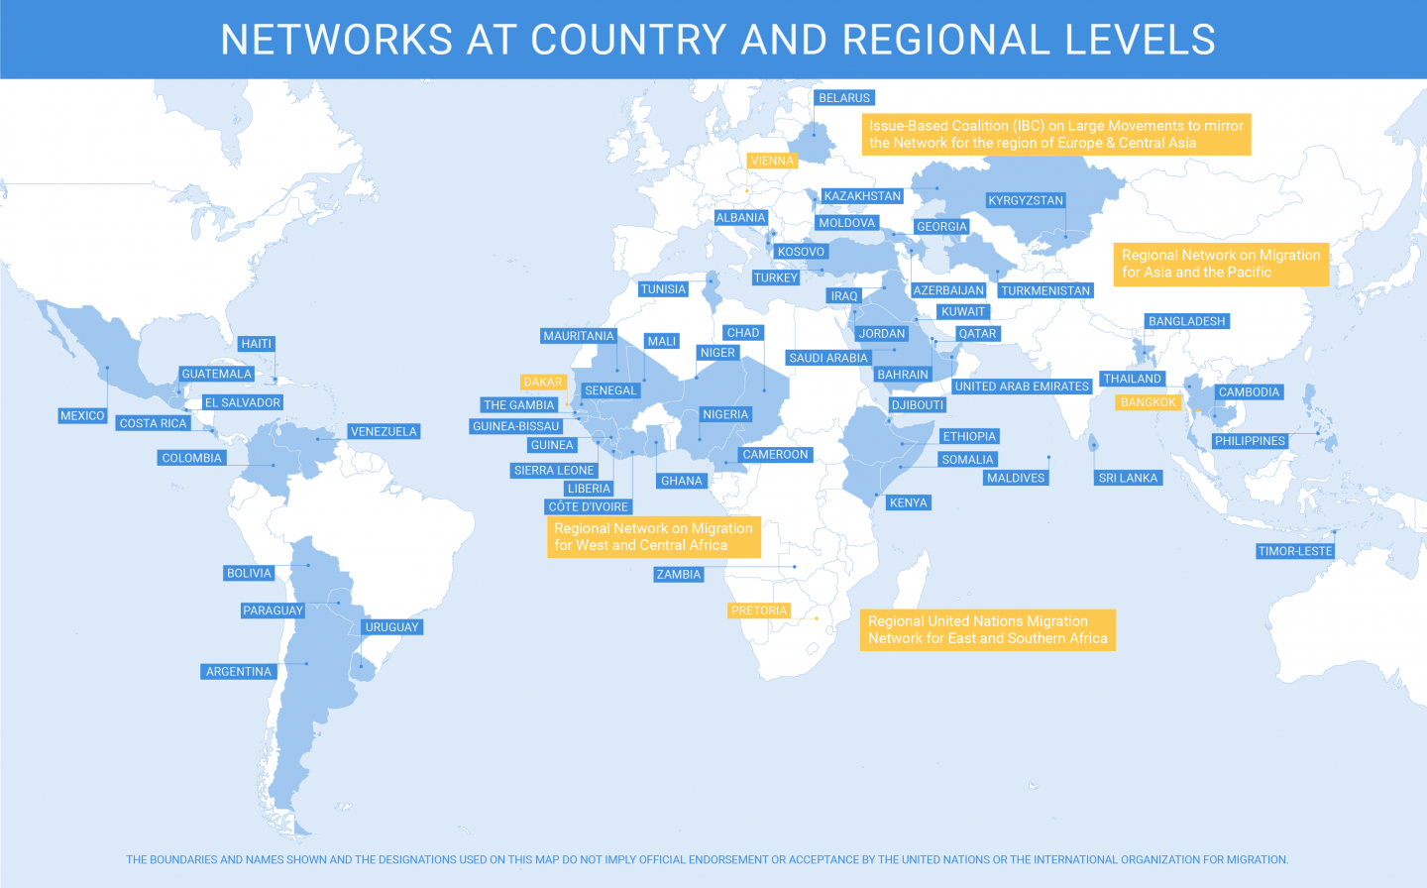

Slide 5
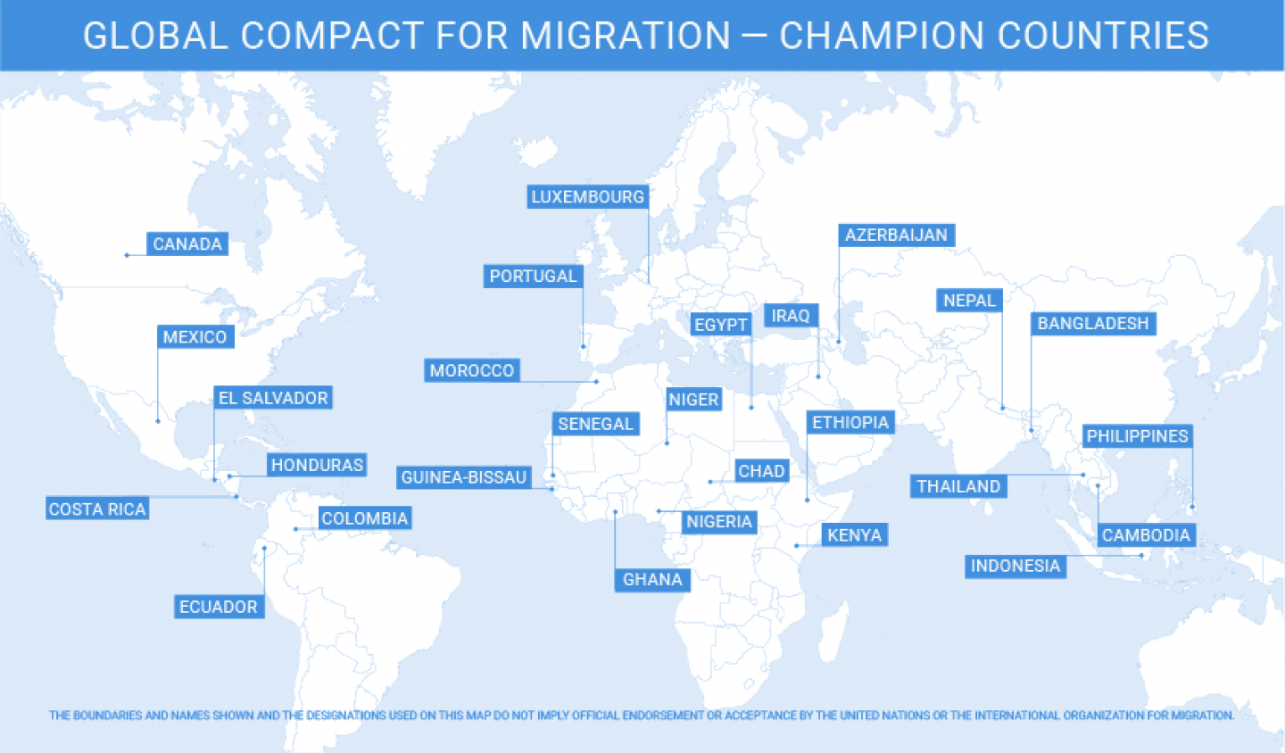

Slide 6
INTERNATIONAL MIGRATION REVIEW FORUM (IMRF)
The first International Migration Review Forum (IMRF) will be held under the auspices of the General Assembly and chaired by the President of the General Assembly. It will take place on 17 - 20 May 2022 at the UNHQ in New York.
It will be preceded by a one-day interactive multi-stakeholder hearing on 16 May 2022.
The purpose of the Forum is to assess the status of the implementation of the Global Compact for Safe Orderly and Regular Migration (GCM), including as it relates to the 2030 Agenda for Sustainable Development, at the local, national, regional and global levels and with the participation of all relevant stakeholders.
The IMRF will (1) provide an opportunity for Member States and other relevant stakeholders to discuss and share progress on the implementation of all aspects of the GCM; (2) provide a space for a policy debate focusing on challenges in the implementation of the GCM; and (3) result in a Progress Declaration.

Slide 7
STRUCTURE OF THE IMRF
MULTI-STAKEHOLDER HEARING
16 MAY
(one day prior)
FOUR INTERACTIVE ROUND TABLES
17 AND 18 MAY
(during the first day and the morning of the second day of the Forum)
A POLICY DEBATE
18 MAY
(in the afternoon of the second day of the Forum)
PLENARY DISCUSSIONS
19 AND 20 MAY
(during the third and fourth days of the Forum)
ADOPTION OF A PROGRESS DECLARATION
20 MAY
(during the closing section of the Forum)

Slide 8

IMRF TIMELINE
Migration Week
Launch of the Secretary-General Report on the GCM
Accreditation process
Registration open
International Migration
Review Forum
January -April
16
May
March (TBC)
4 – 26
January
14-18
February
March
(TBC*)
17-20
May
Consultation with stakeholders on the organization of the Multi-stakeholder hearing and stakeholder engagement during the IMRF
IMRF Dialogue Series
Multi-stakeholder hearing
* Subject to confirmation by the Office of the President of the United Nations General Assembly

Slide 9
IMRF ROADMAP
ENTRY POINTS FOR ENGAGEMENT
Pledging Initiative
Voluntary GCM Reviews
IMRF Dialogue Series
Migration Network Hub
Discussion Spaces
Repository of Practices
Platforms for stakeholder engagement at the country and regional level
Migration Week
Launch of the Secretary-General Biennal Report on the GCM
Multi-stakeholder hearing
IMRF Policy Debate and Round Tables

Slide 10
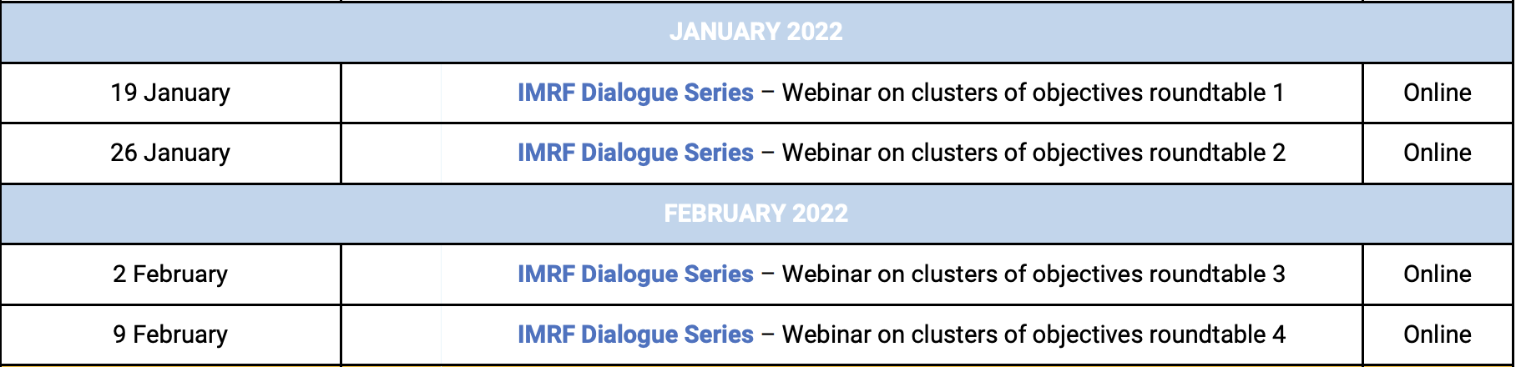
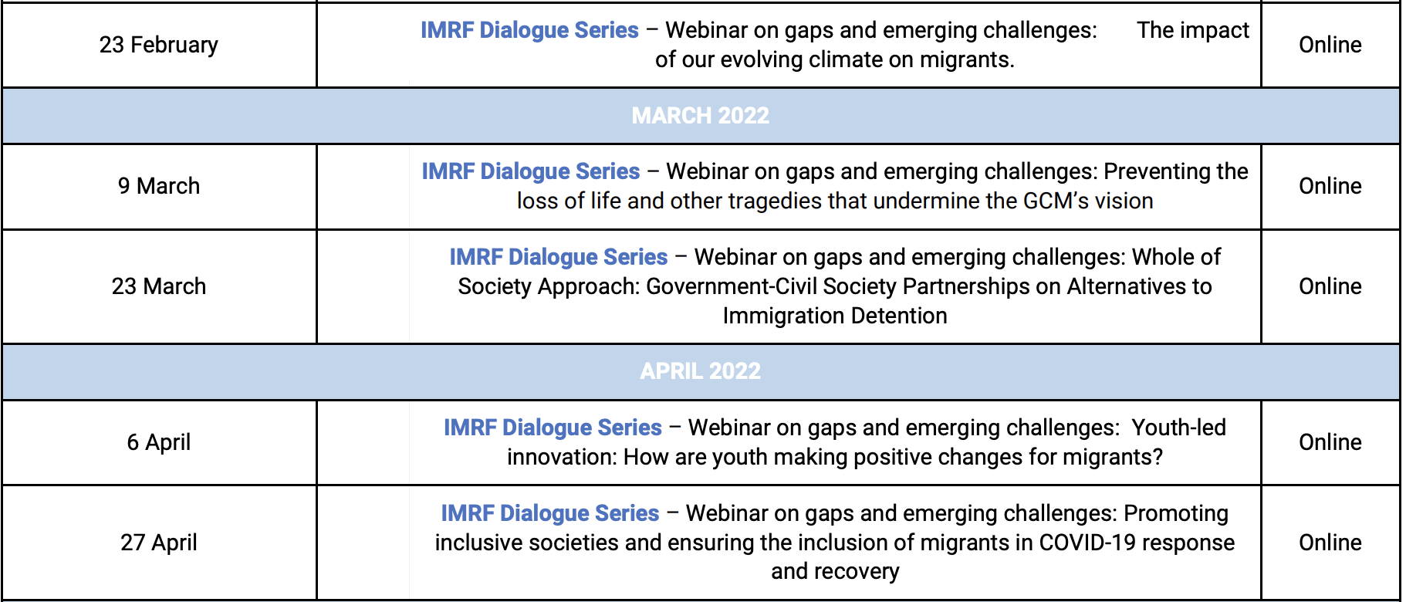
IMRF DIALOGUE SERIES

Slide 11

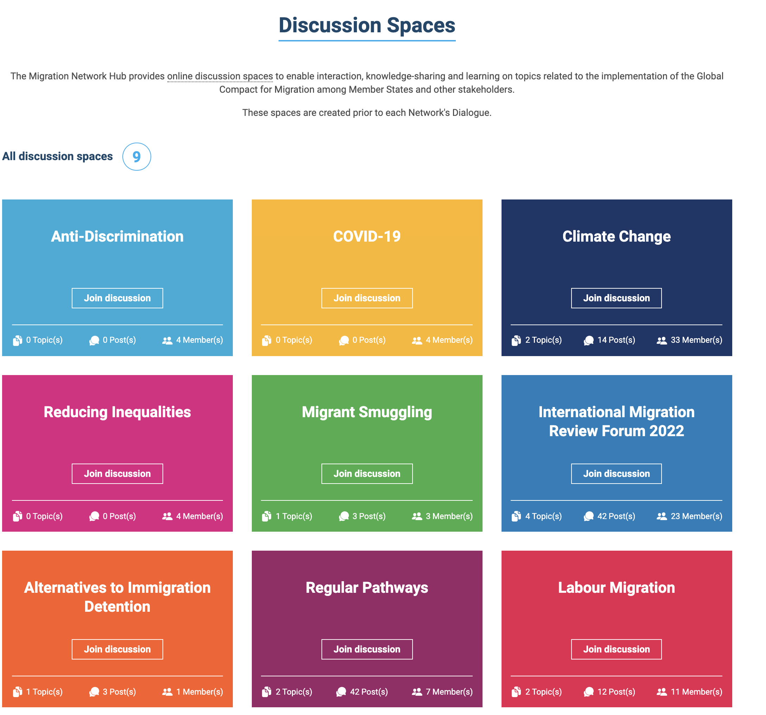
MIGRATION NETWORK HUB

Slide 12
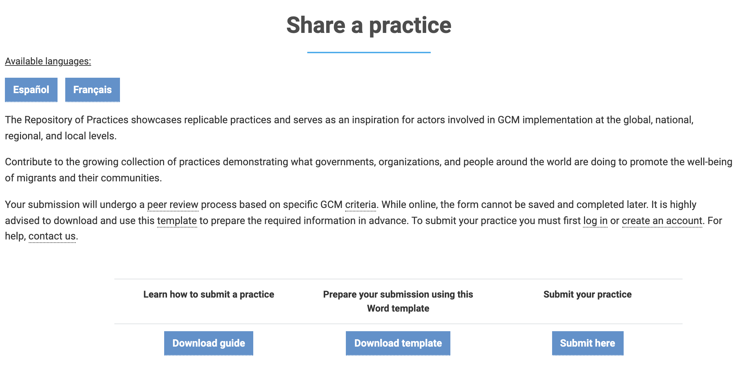
MIGRATION NETWORK HUB:
REPOSITORY OF PRACTICES

Slide 13
MIGRATION WEEK
The Network will host the Migration Week on 14 - 18 February 2022.
The theme for the 2022 Migration Week is “Cooperation and Partnership: Implementing the Global Compact for Safe, Orderly and Regular Migration”.
The Briefing on the Secretary-General Biennial Report on the GCM took place on 16 February 2022 from 10:00-11:30 NY time.

Slide 14

THE PLEDGING INITIATIVE
The Network launched the Pledging Initiative on 17 December 2021 to help build momentum for the IMRF and to assist all actors in contributing to the implementation of the GCM in tangible ways.
A pledge is a measurable commitment to advance the implementation of one or more GCM guiding principles, objectives, or actions while considering the 360-degree approach of the GCM.

Slide 15
unmignet@iom.int
www.migrationnetwork.un.org
Follow us on Twitter! @UNMigNetwork

